Slide 1

CSE 229:Engineering ethics and cyber law
Presented by:
Dr. Mst. Jannatul Ferdous
Professor
Department of Computer Science and Engineering
Jatiya Kabi Kazi Nazrul Islam University, Bangladesh
Email: mjferdous_cse@jkkniu.edu.bd, mjannatul@gmail.com
22nd October, 2024

Slide 2
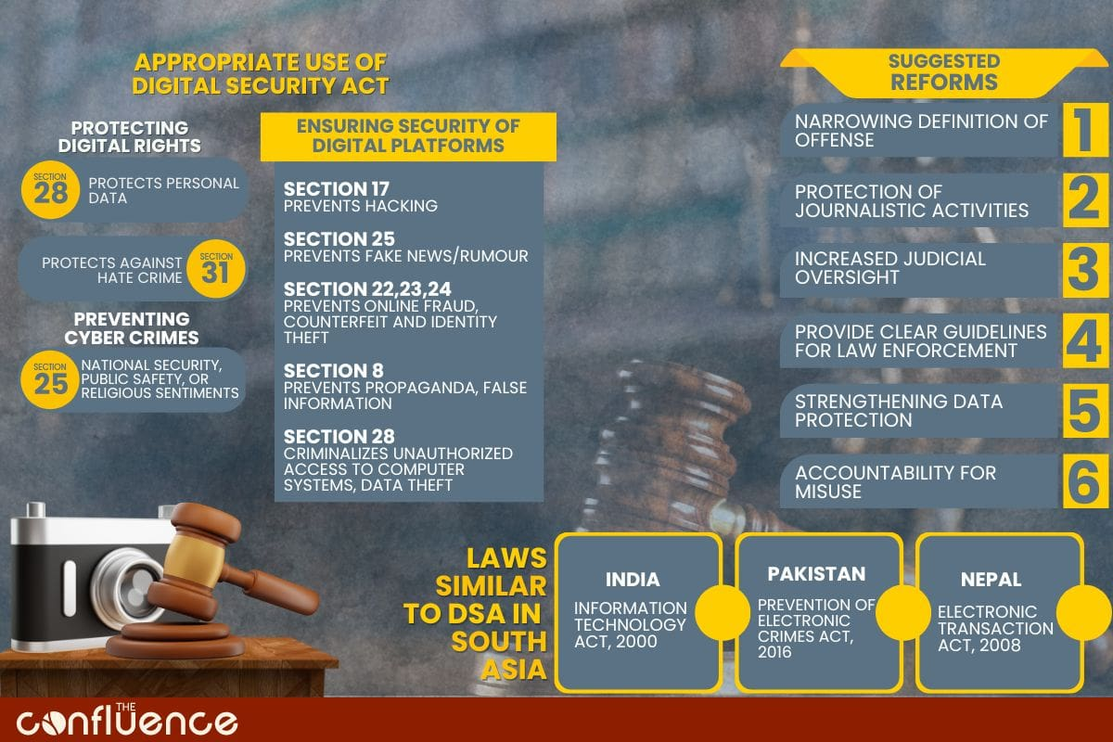

Slide 3
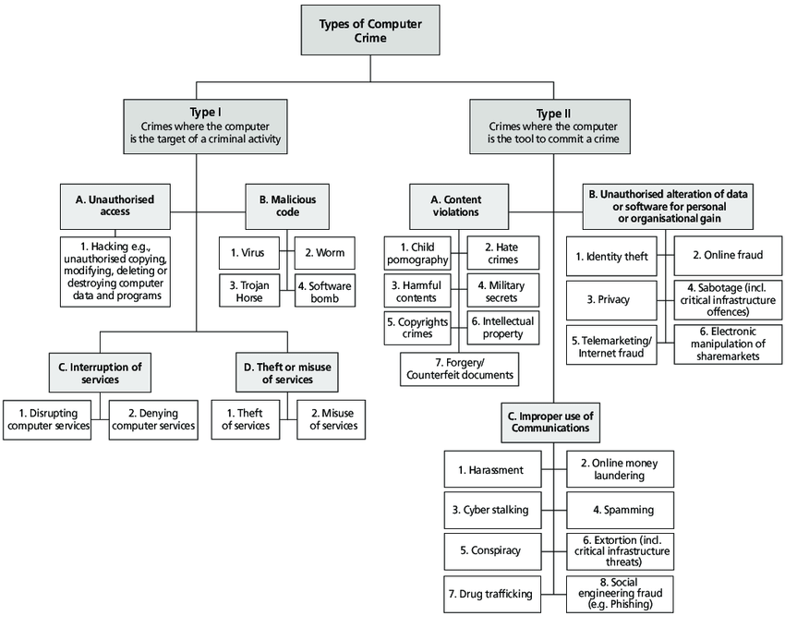

Slide 4
Cyber
“Cyber” is a prefix used to describe a person, thing, or idea as part of the computer and information age. It has been taken from Kubernetes, the Greek word for “steersman” or “governor,” it was first used in cybernetics, a word coined by Norbert Wiener and his colleagues. The virtual world of the internet is known as cyberspace and the laws governing this area are known as Cyber laws all the netizens of this space come under the ambit (পরিধি)of these laws as they carry a kind of universal jurisdiction.
Cyber law can also be described as that branch of law that deals with legal issues related to the use of inter-networked information technology. In short, cyber law is the law governing computers and the internet.

Slide 5
Cyberlaw is important because it
touches almost all aspects of transactions and activities on and involving the Internet,
World Wide Web and cyberspace. Every action and reaction in cyberspace has some legal and cyber legal perspectives.
Cyber law encompasses laws relating to –
a) Cybercrimes
b) Electronic and digital signatures
c) Intellectual property
d) Data protection and privacy

Slide 6
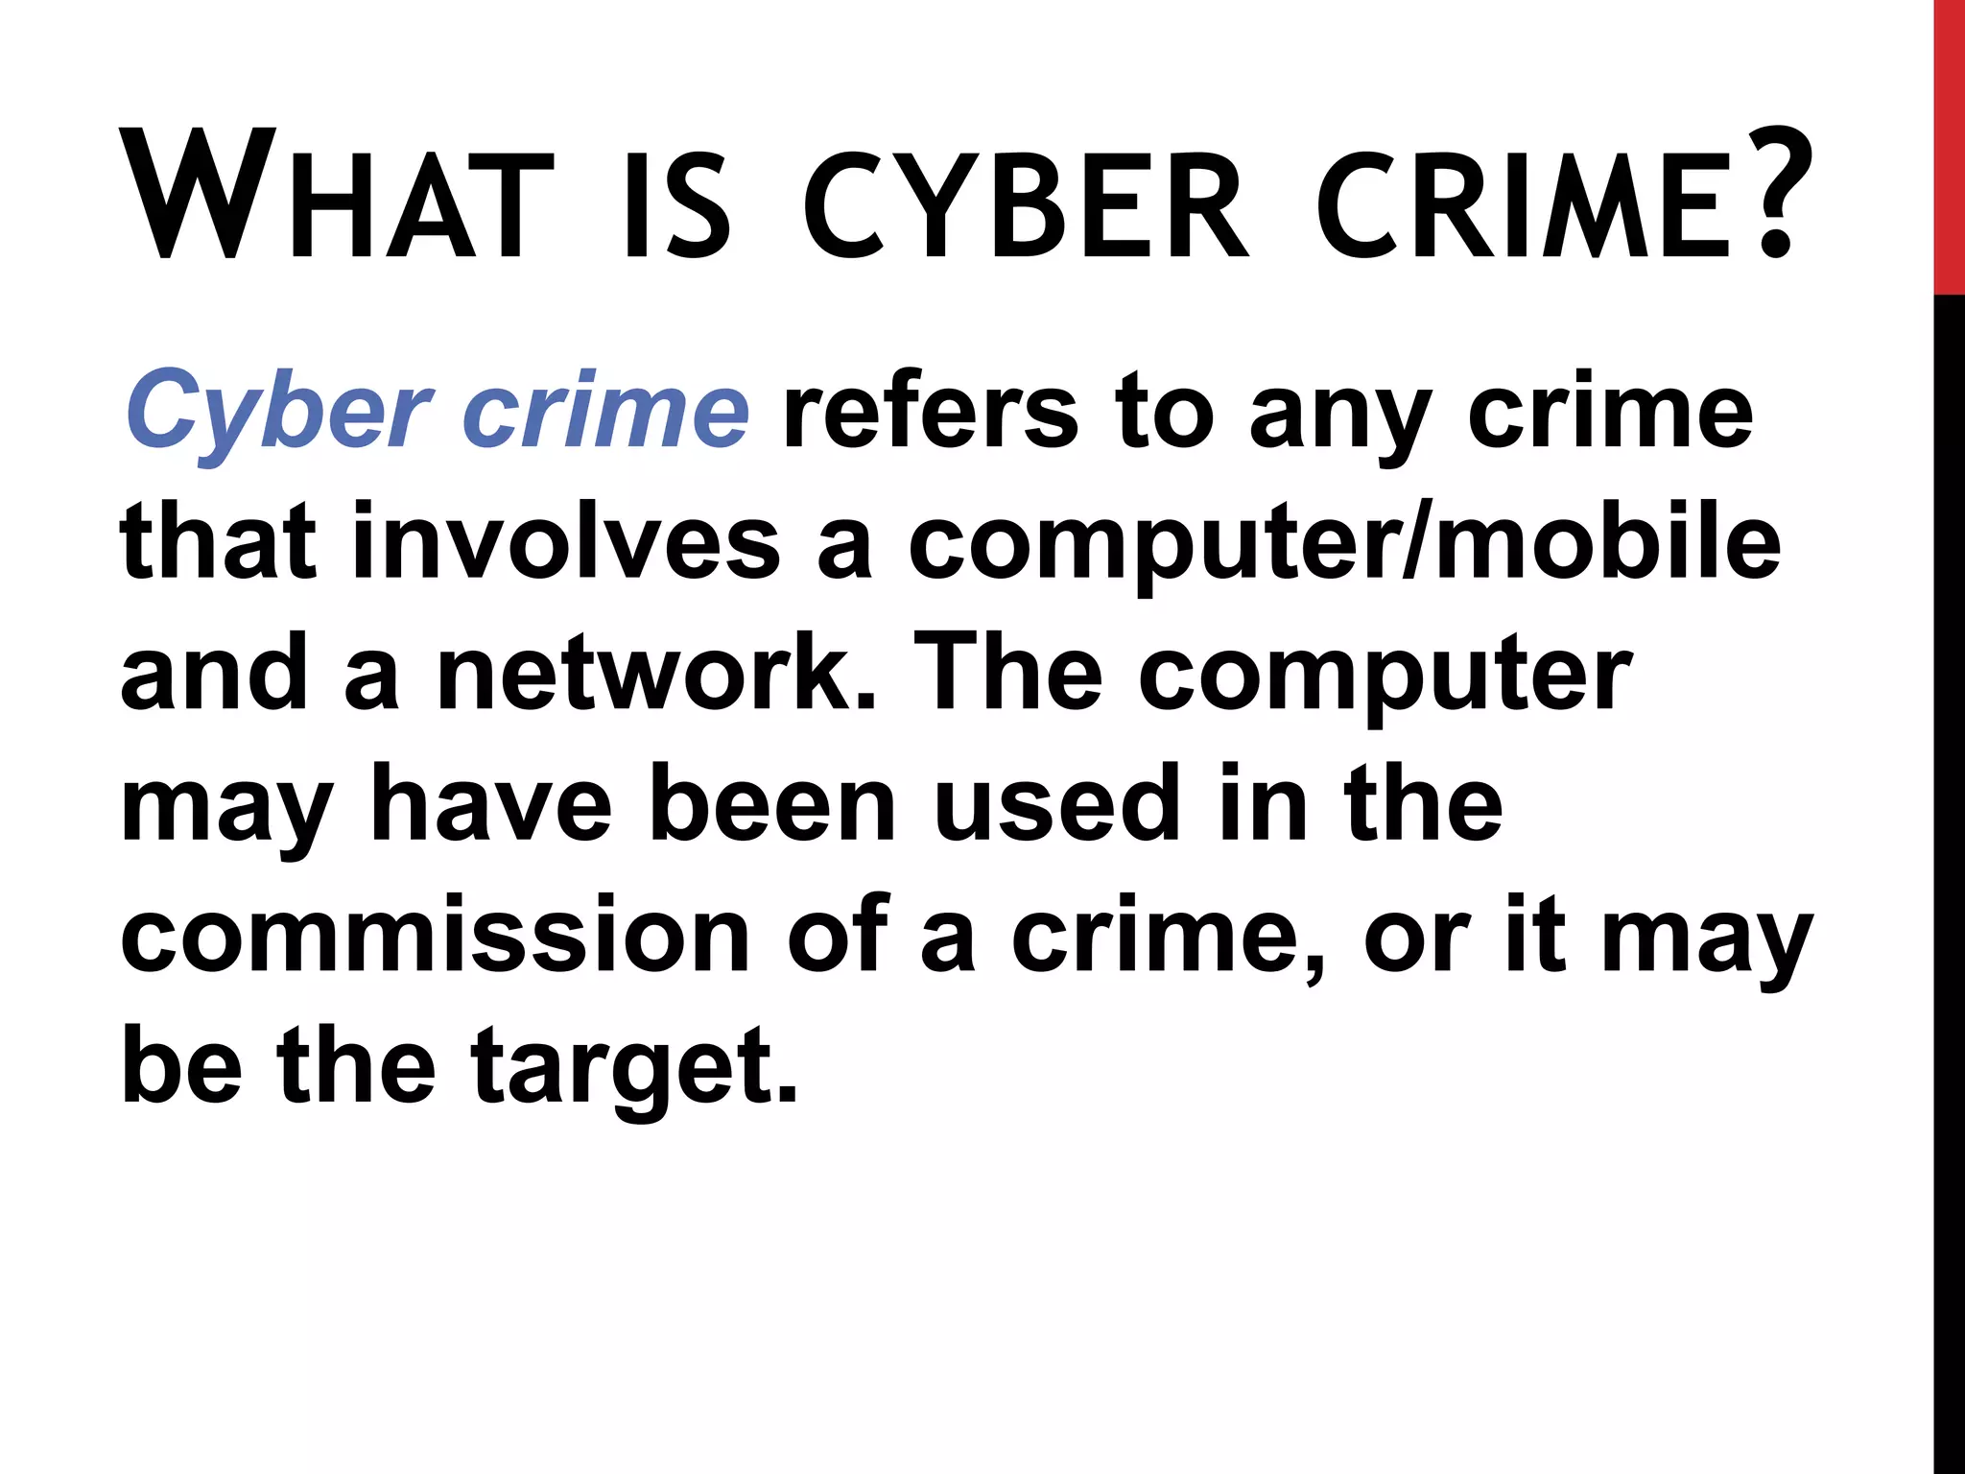
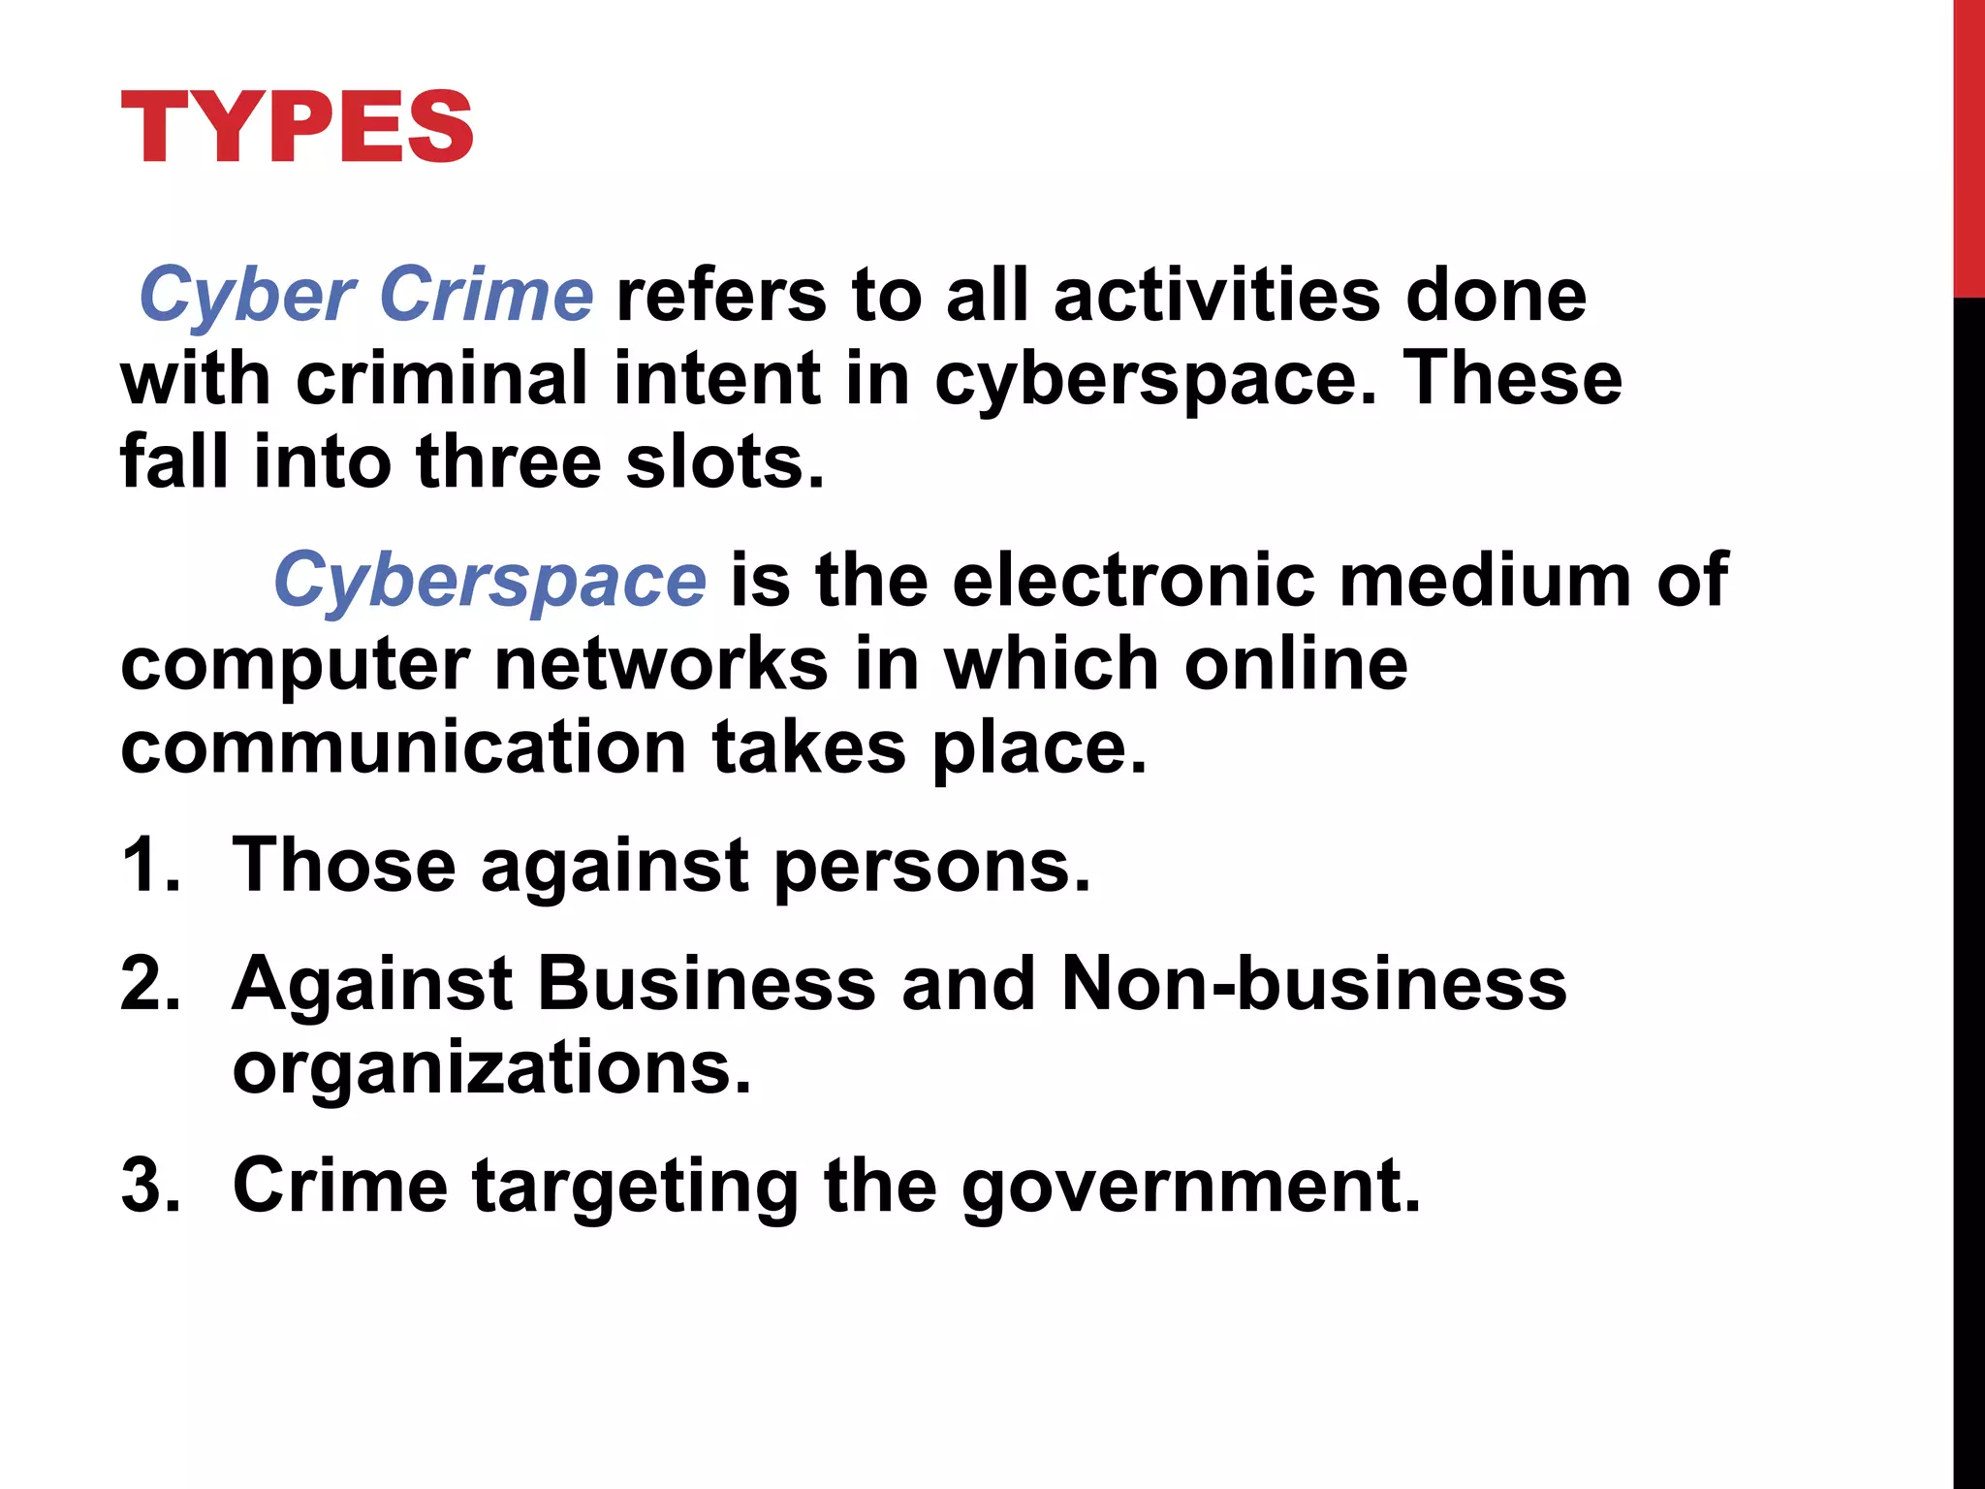
What is Cyber Crime?

Slide 7
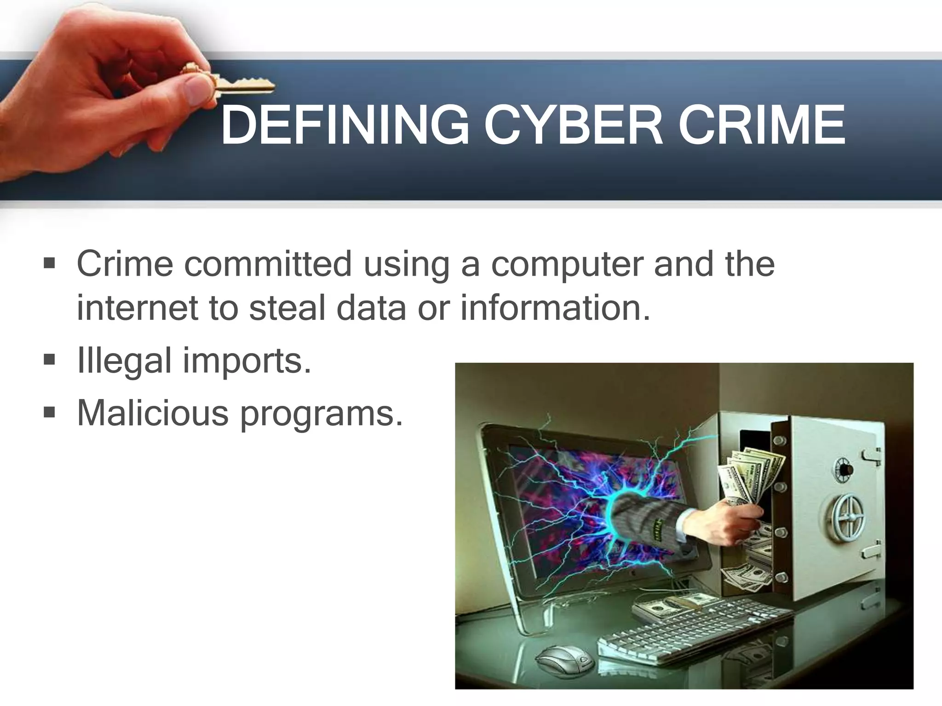
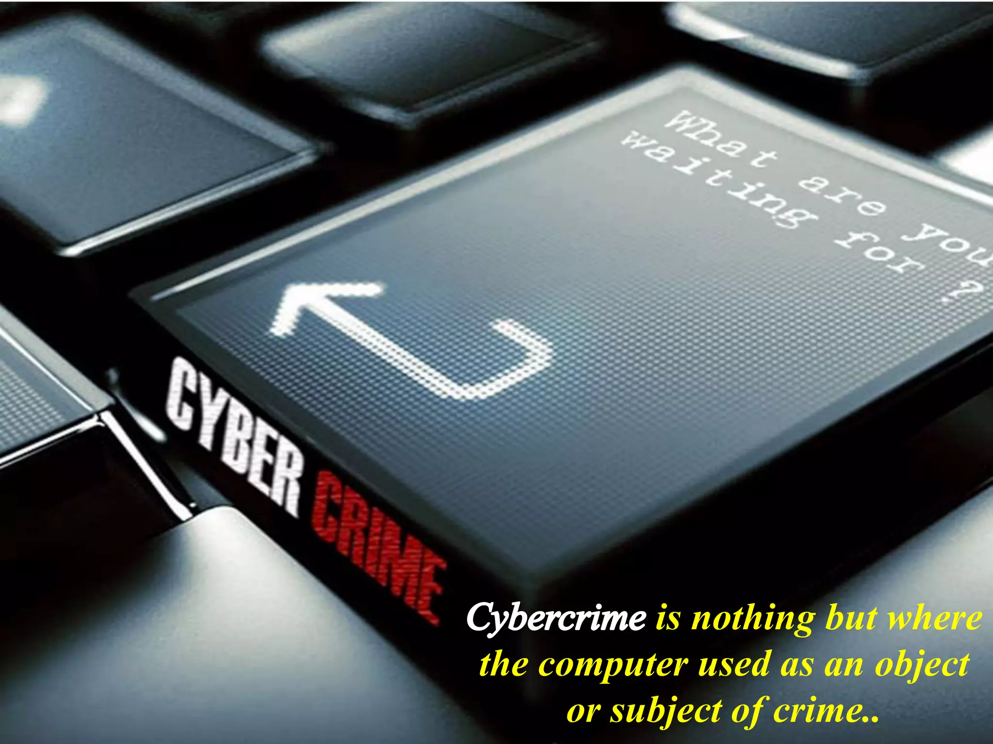
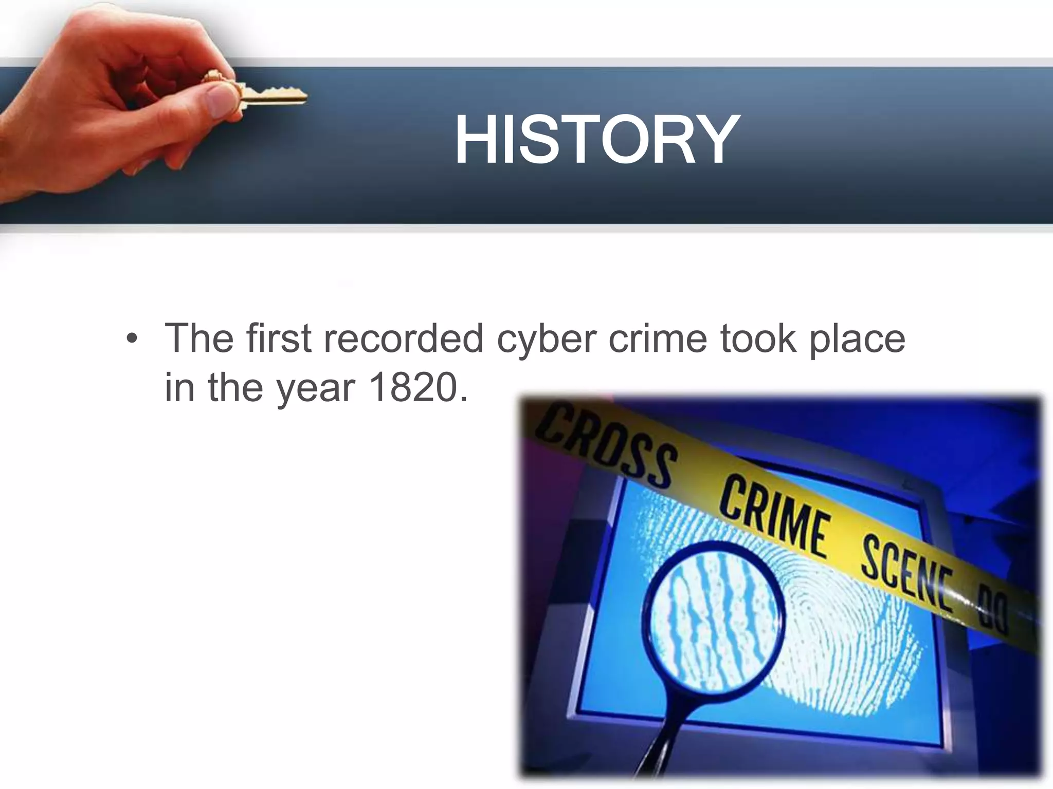

Slide 8
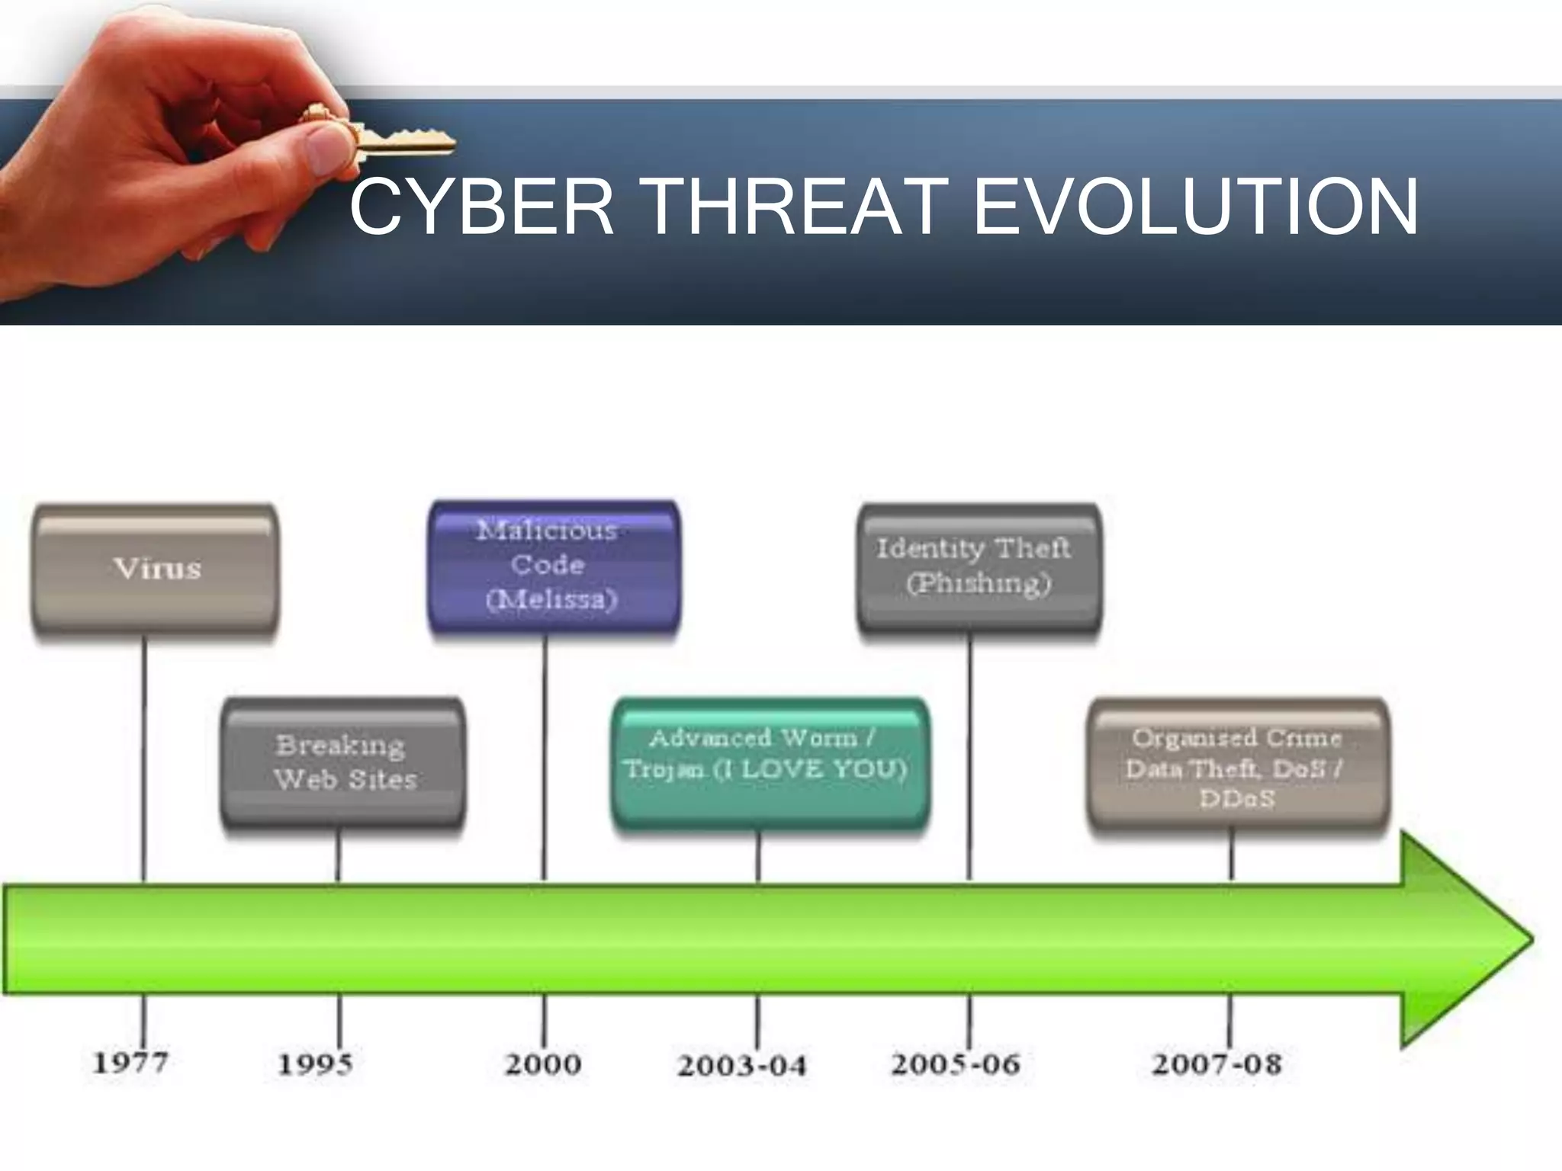
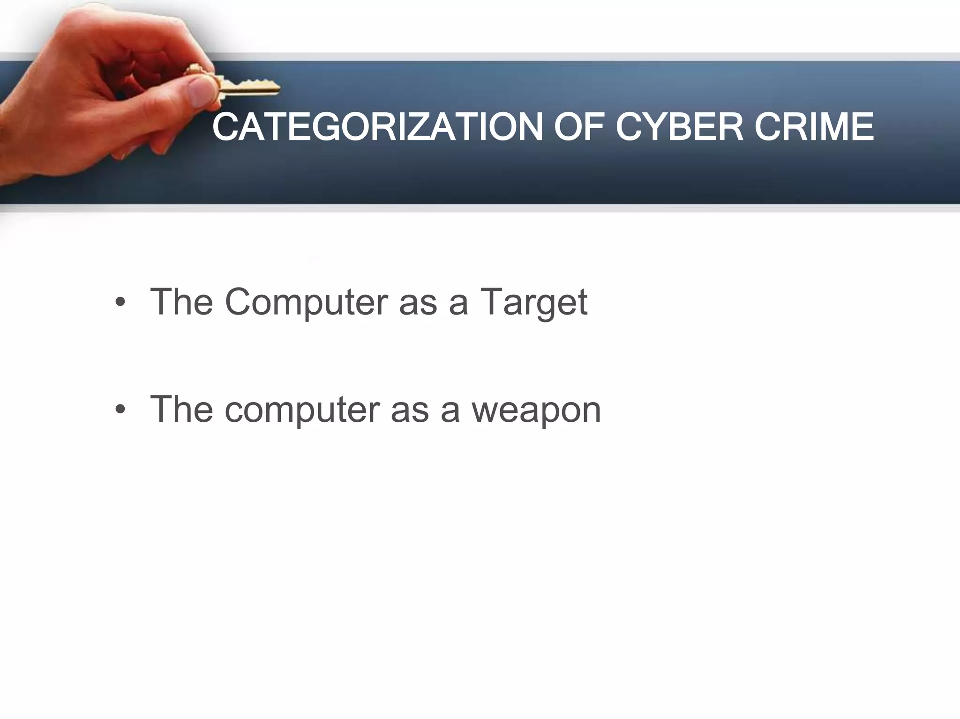
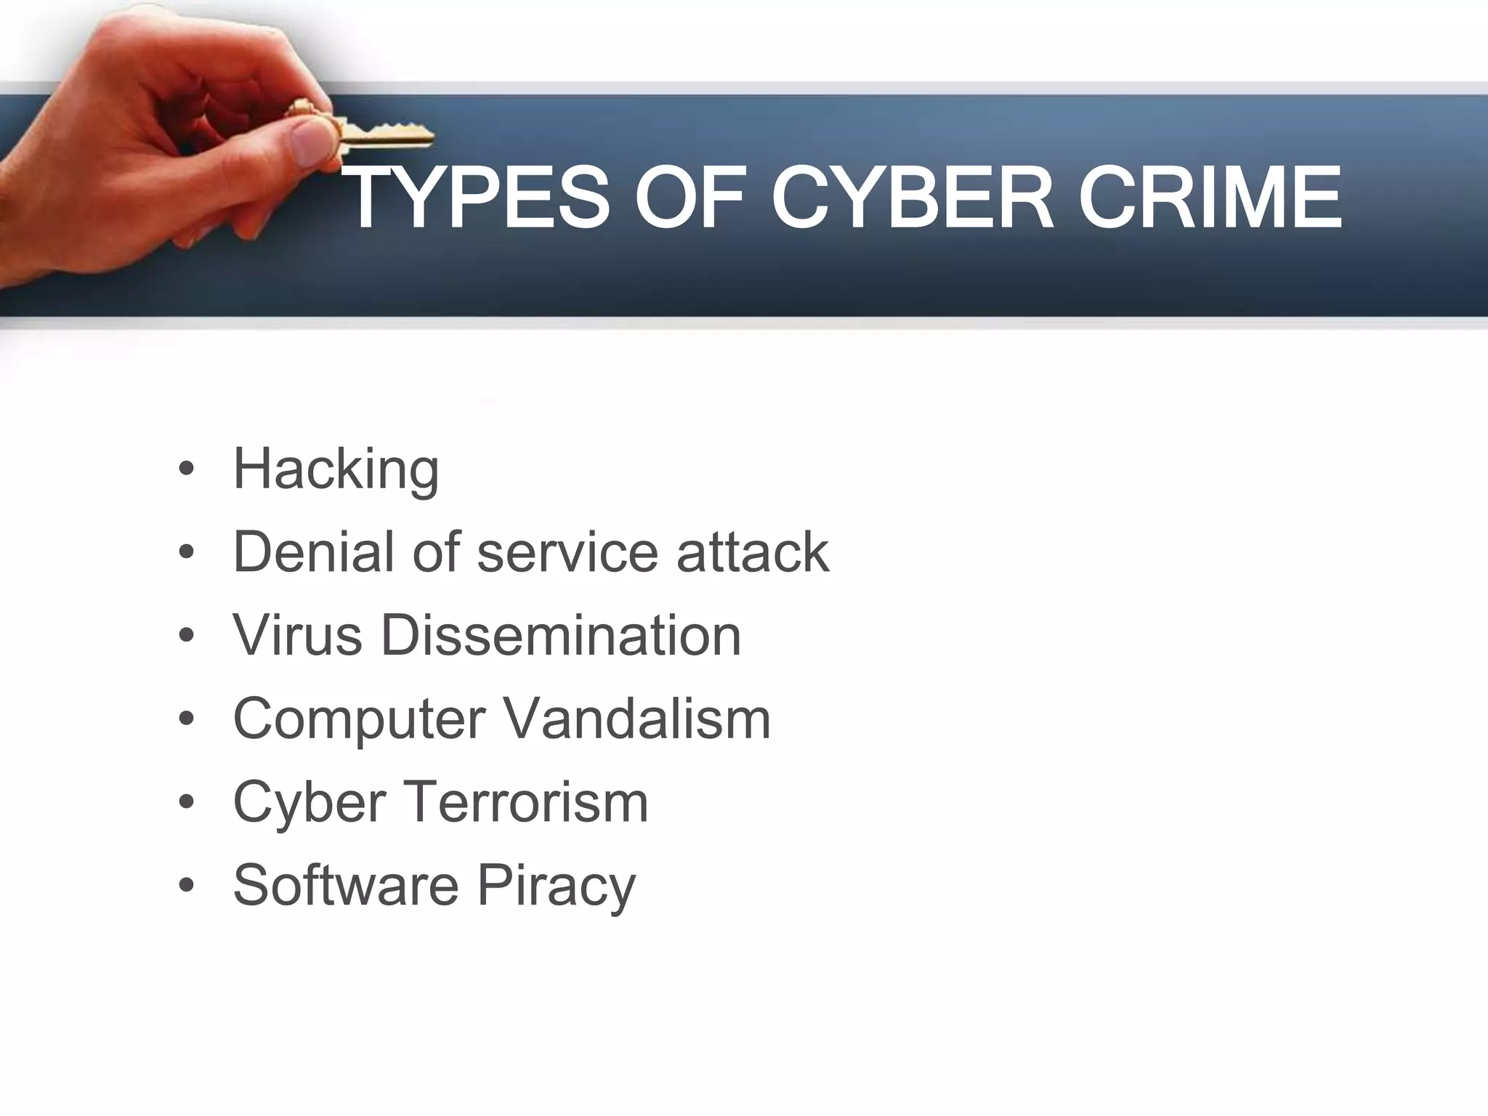

Slide 9
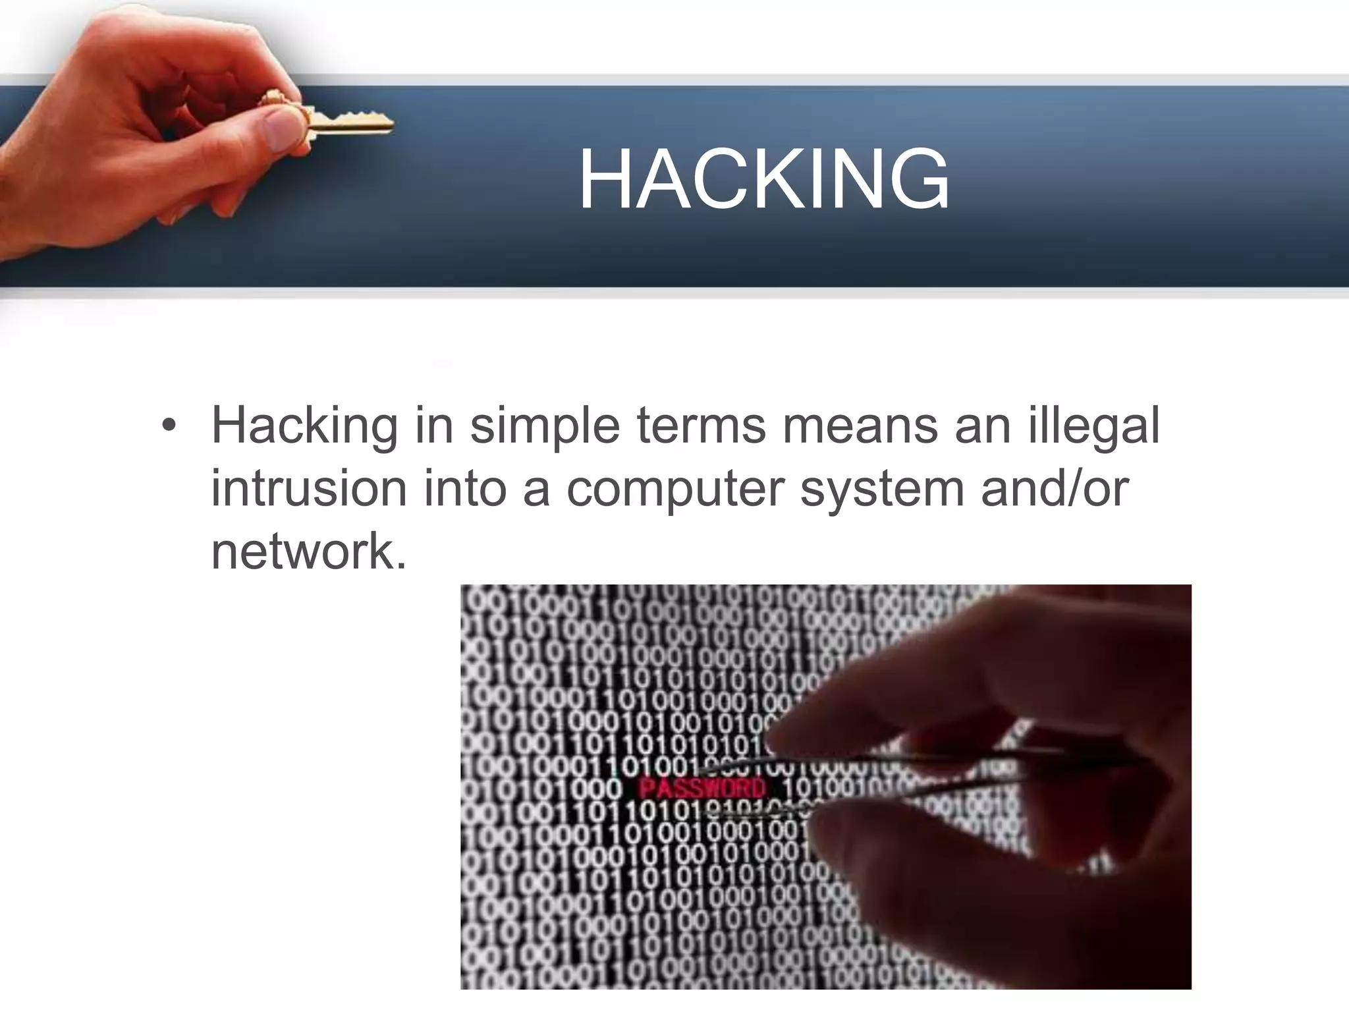
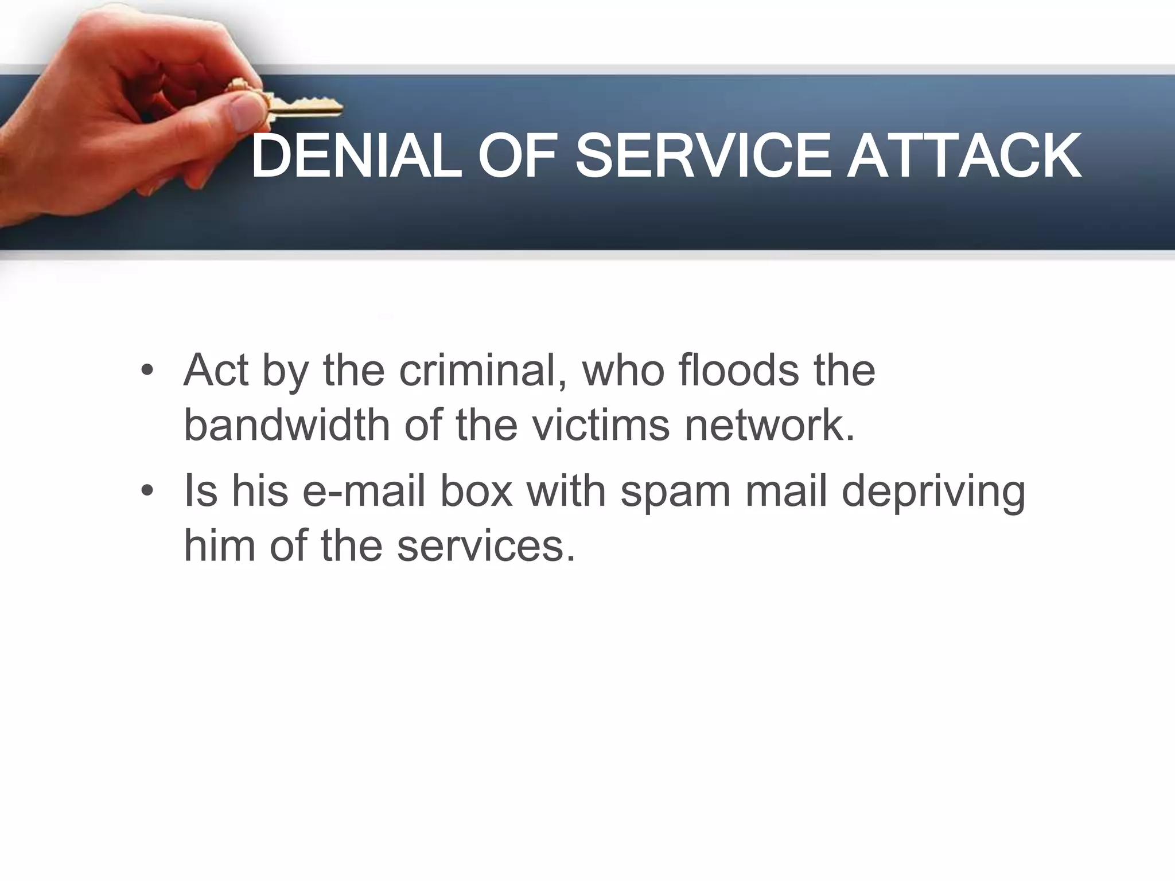
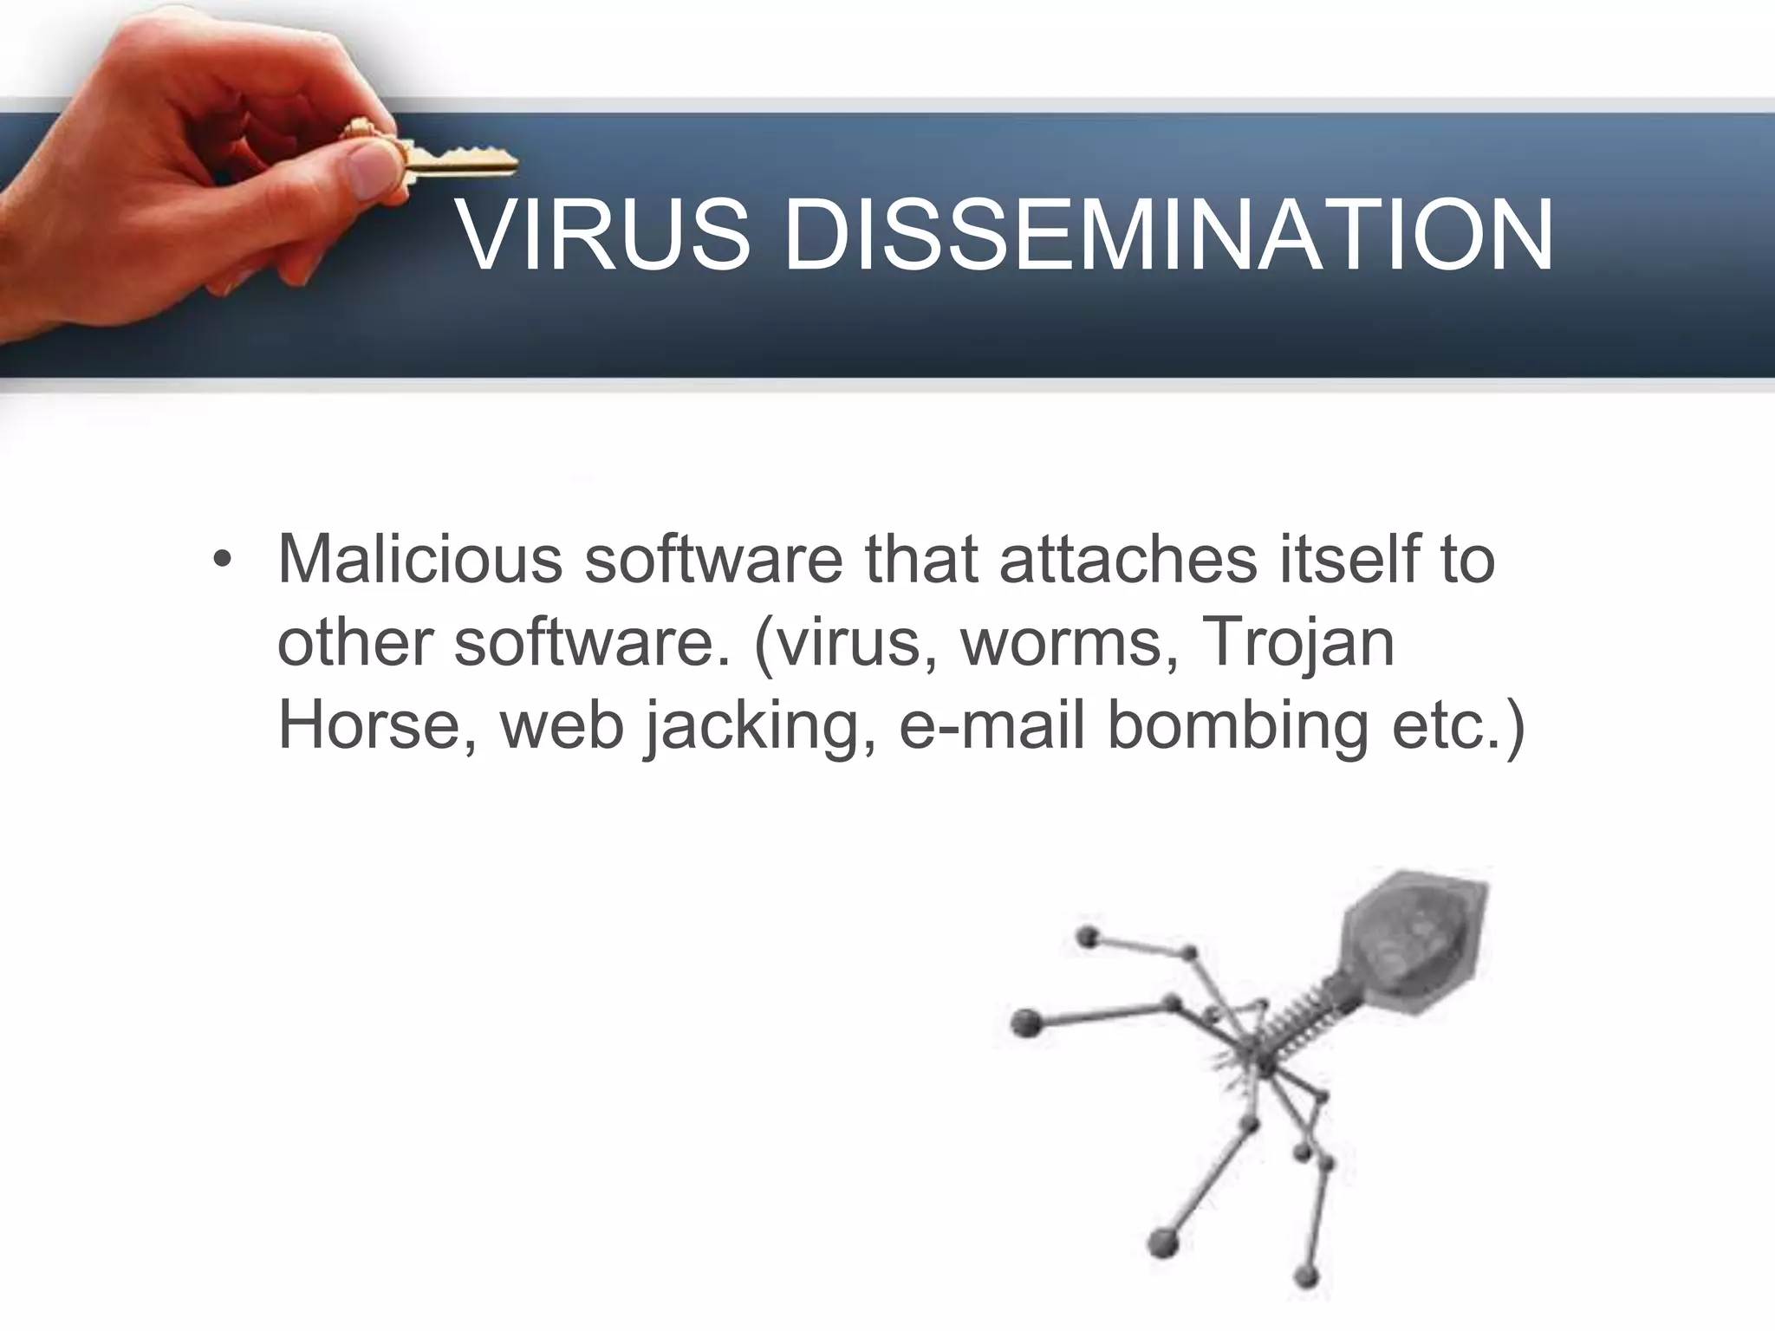

Slide 10
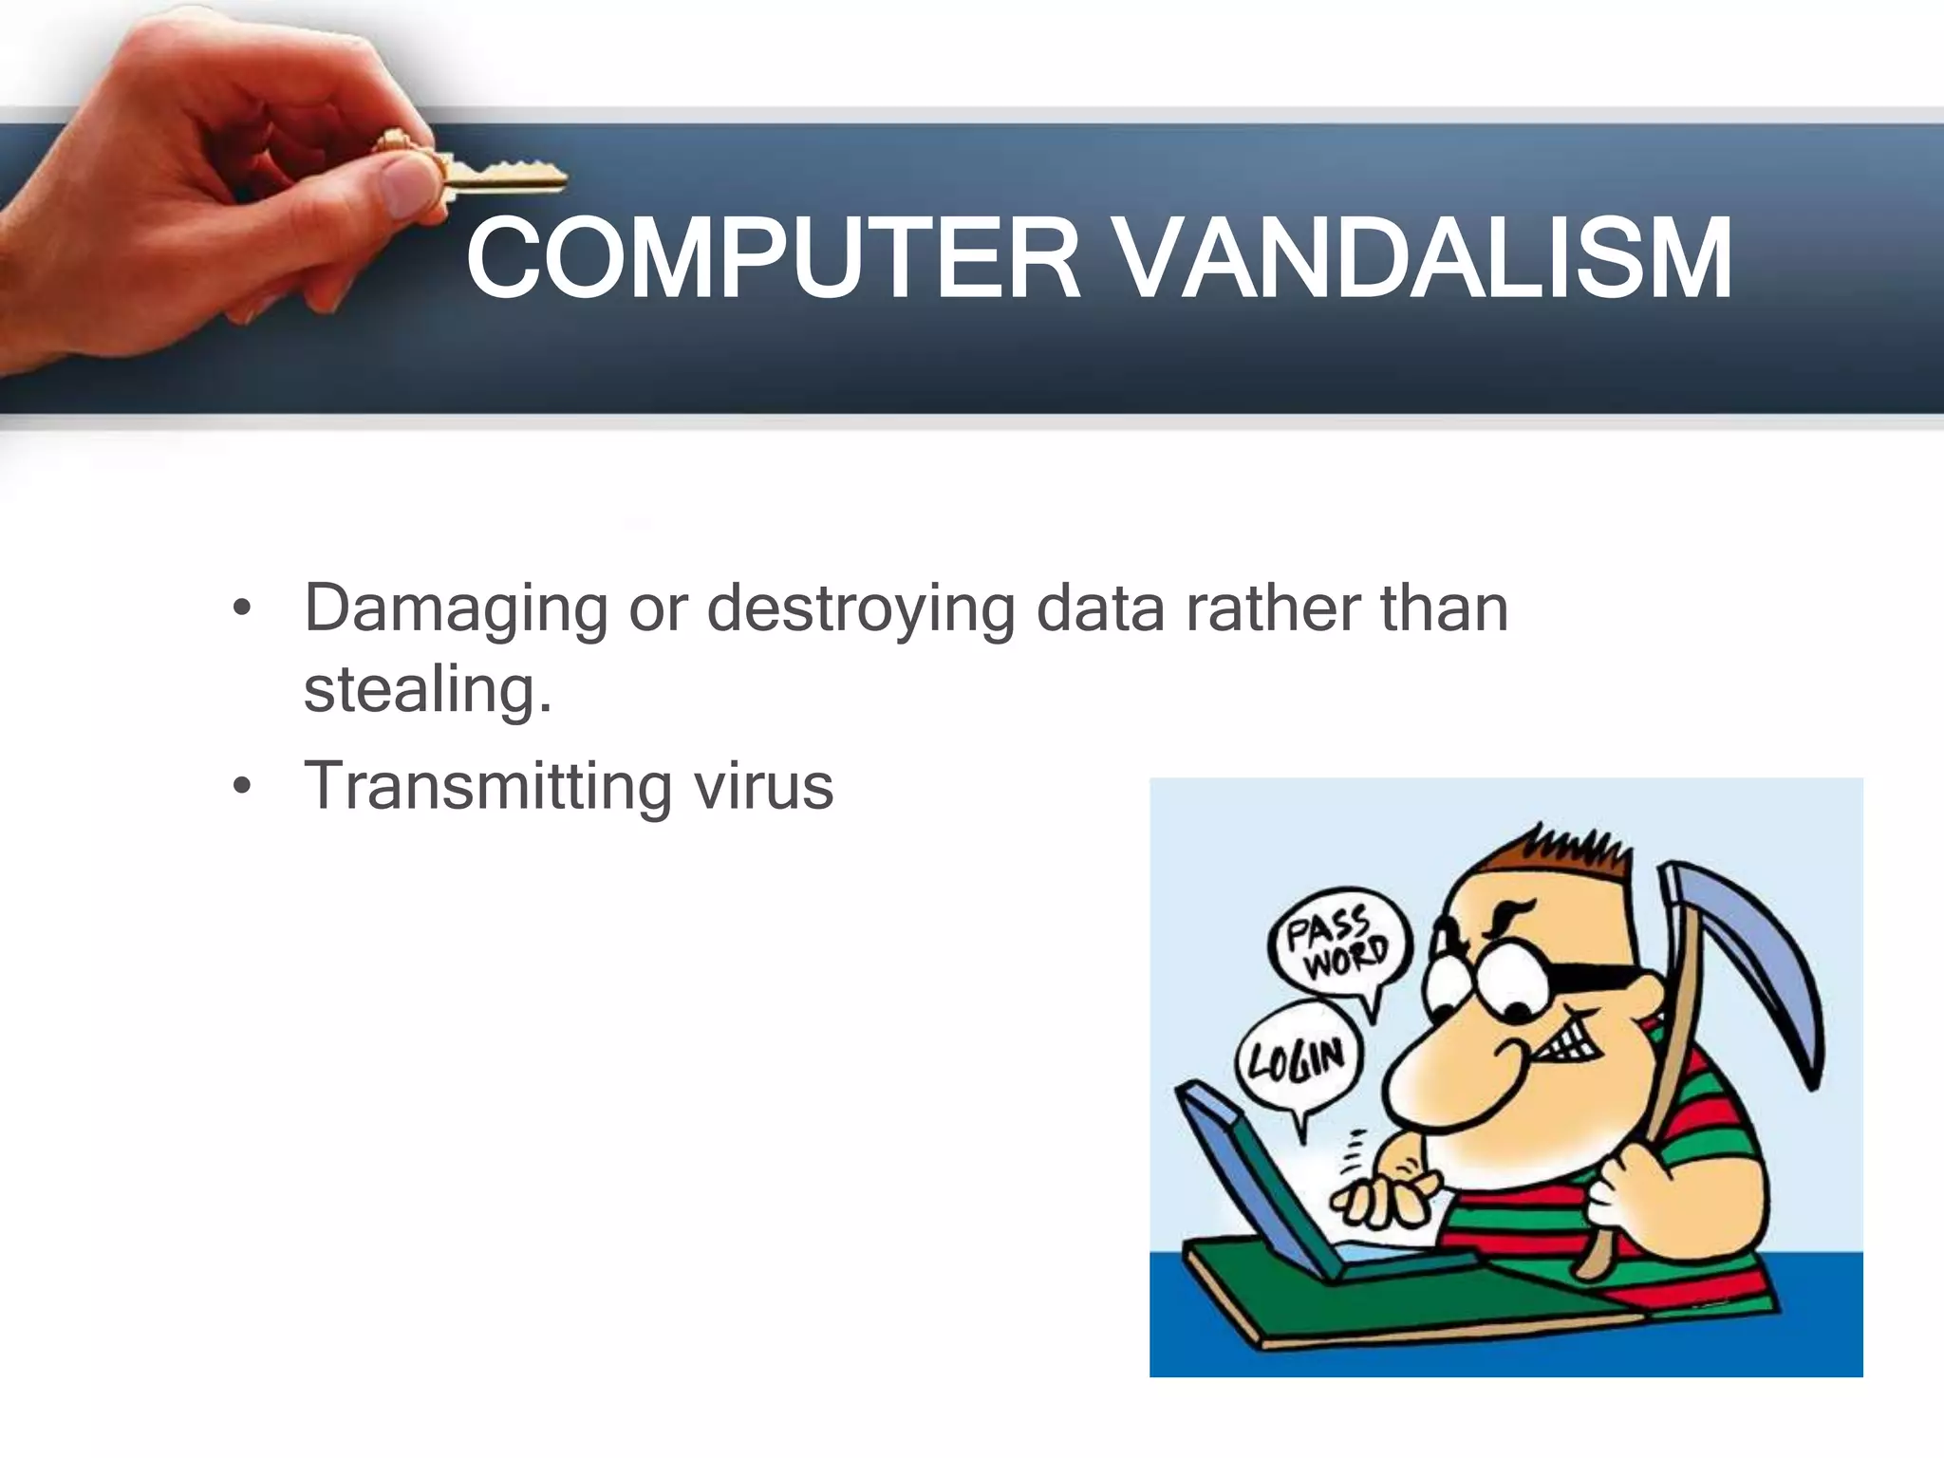
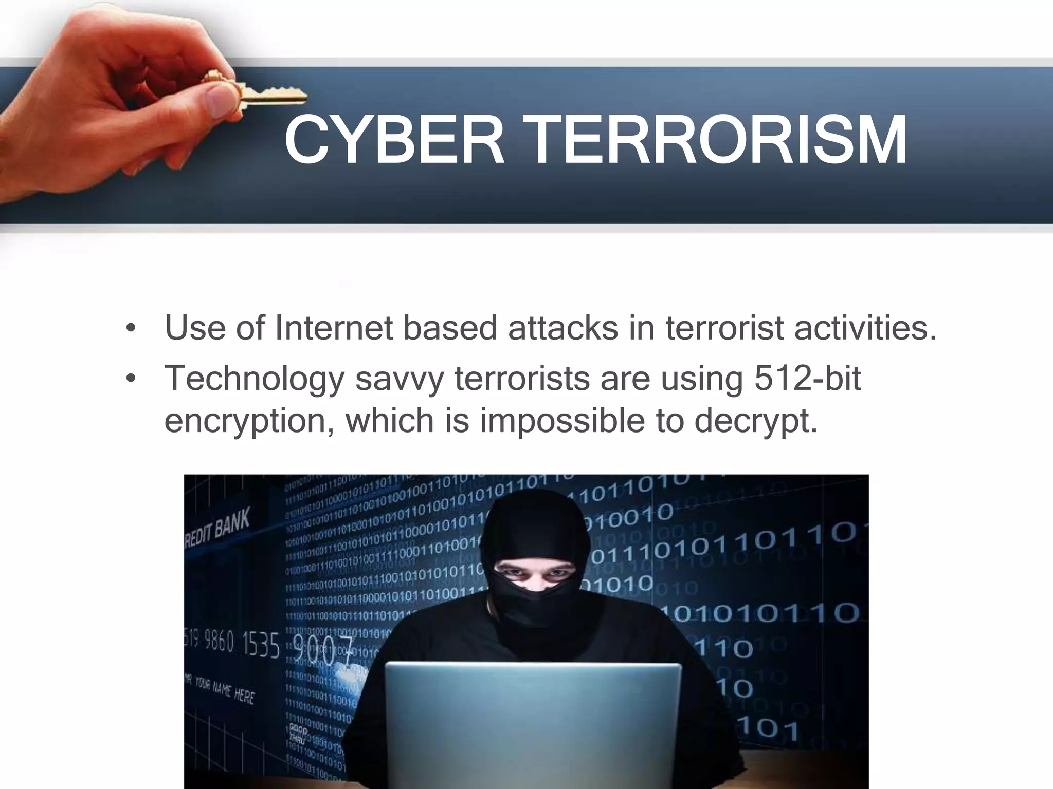
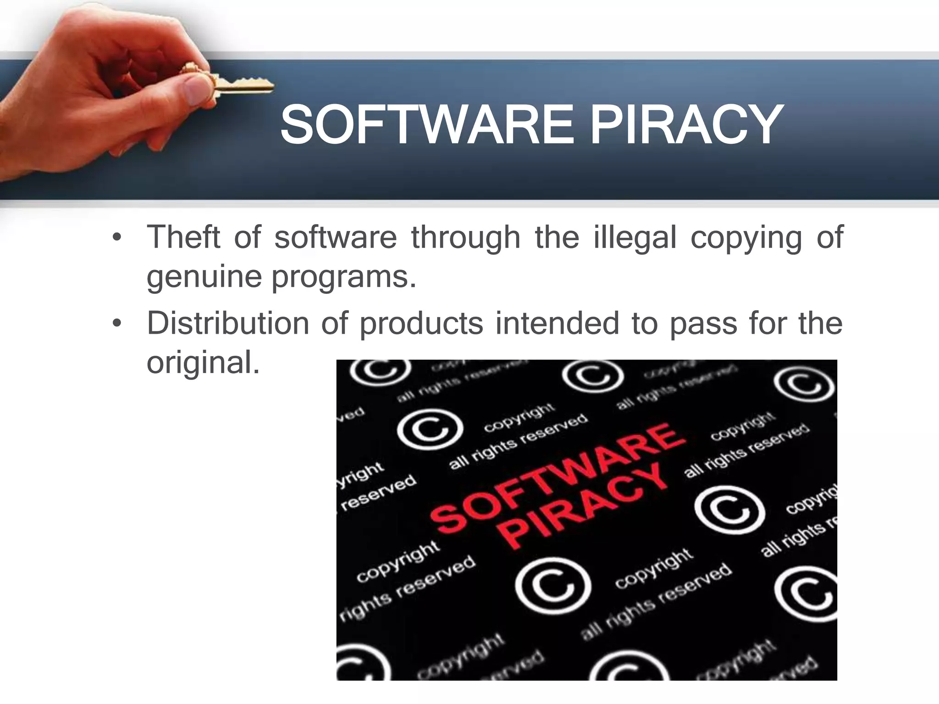
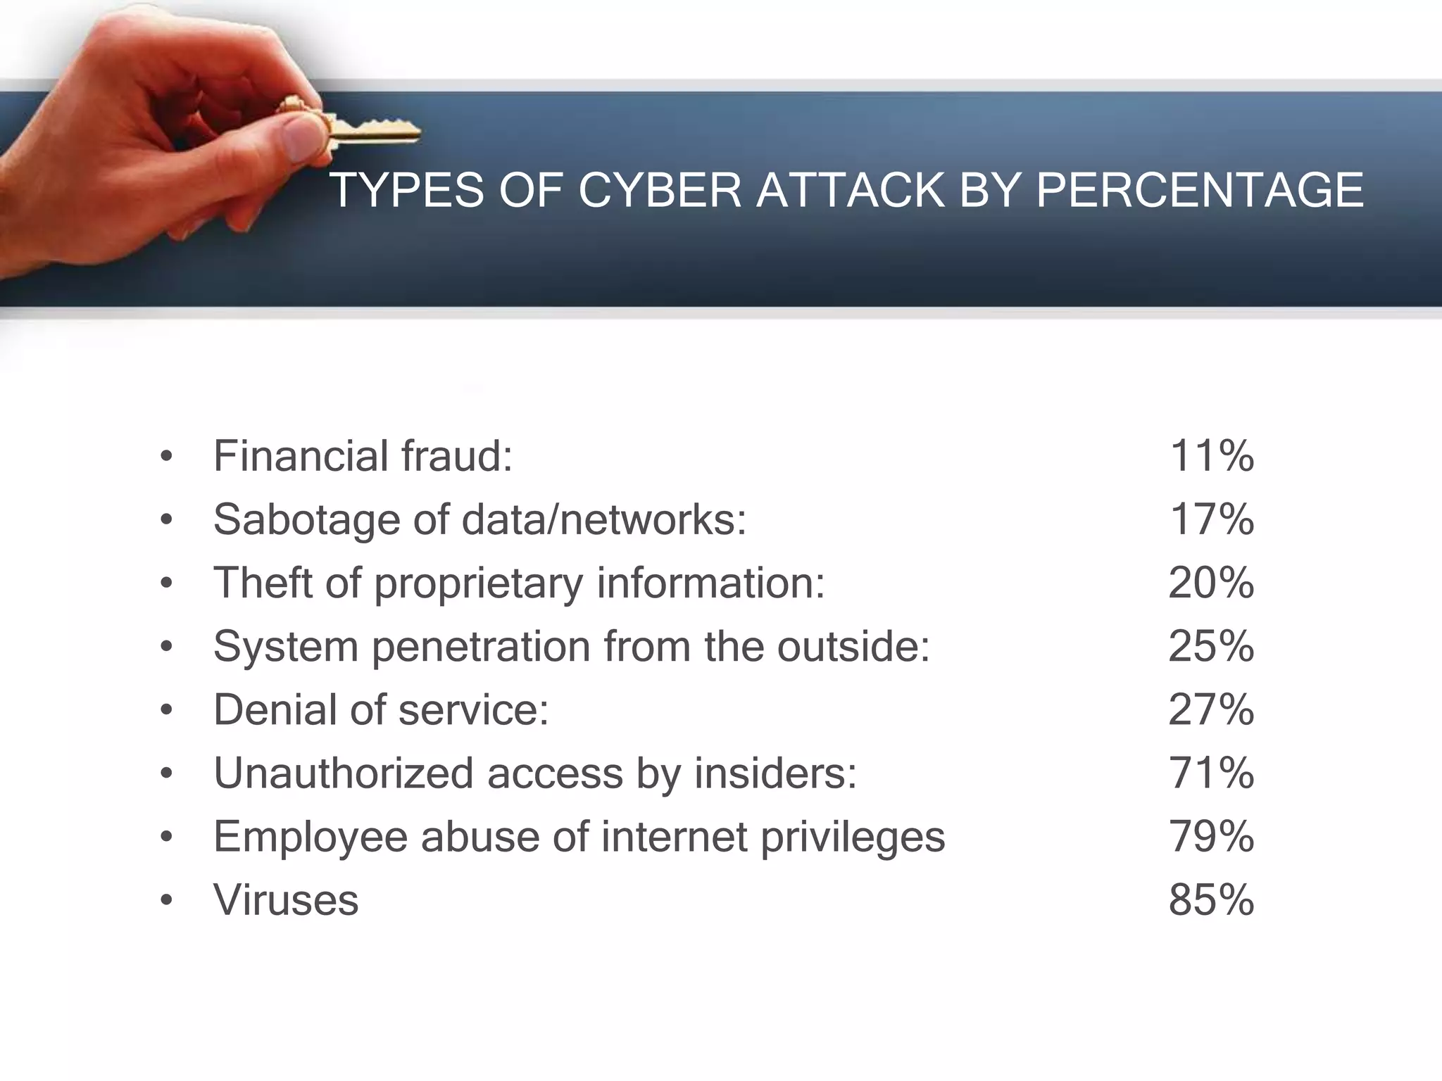
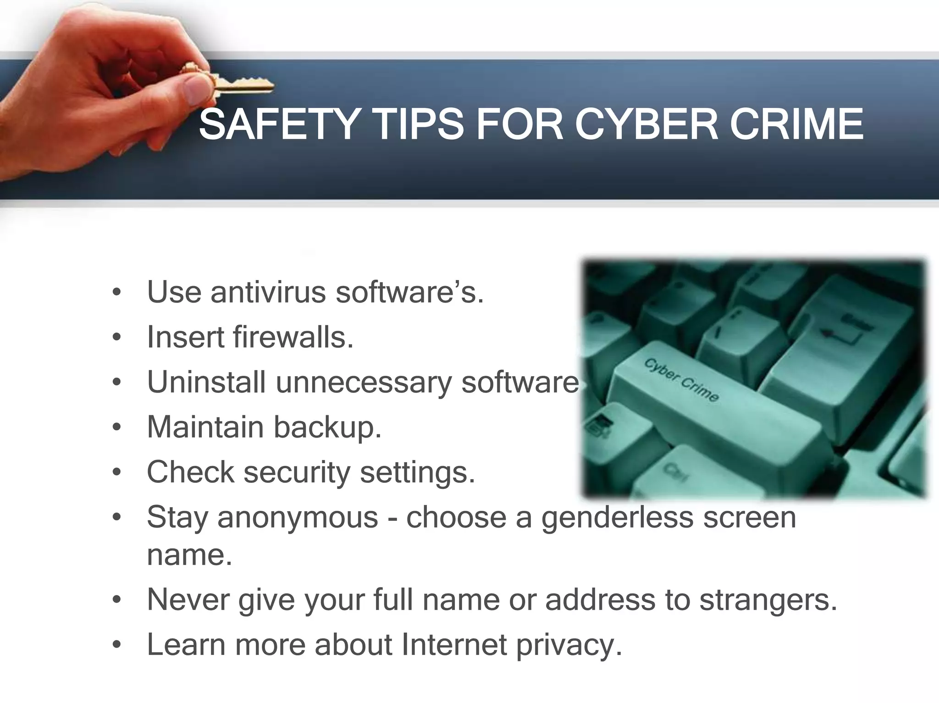
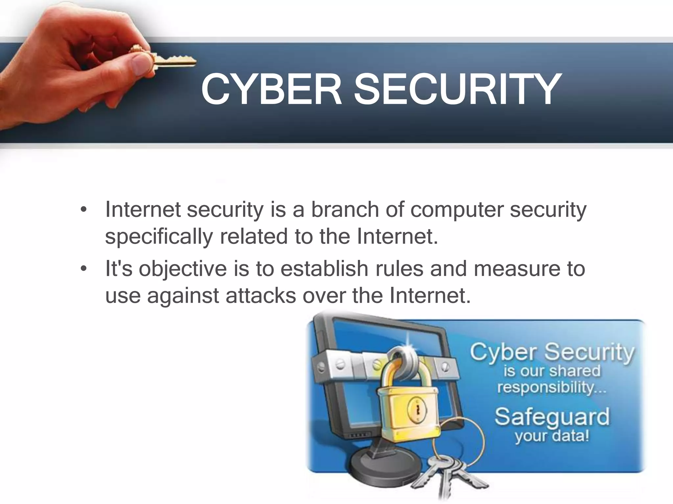

Slide 11
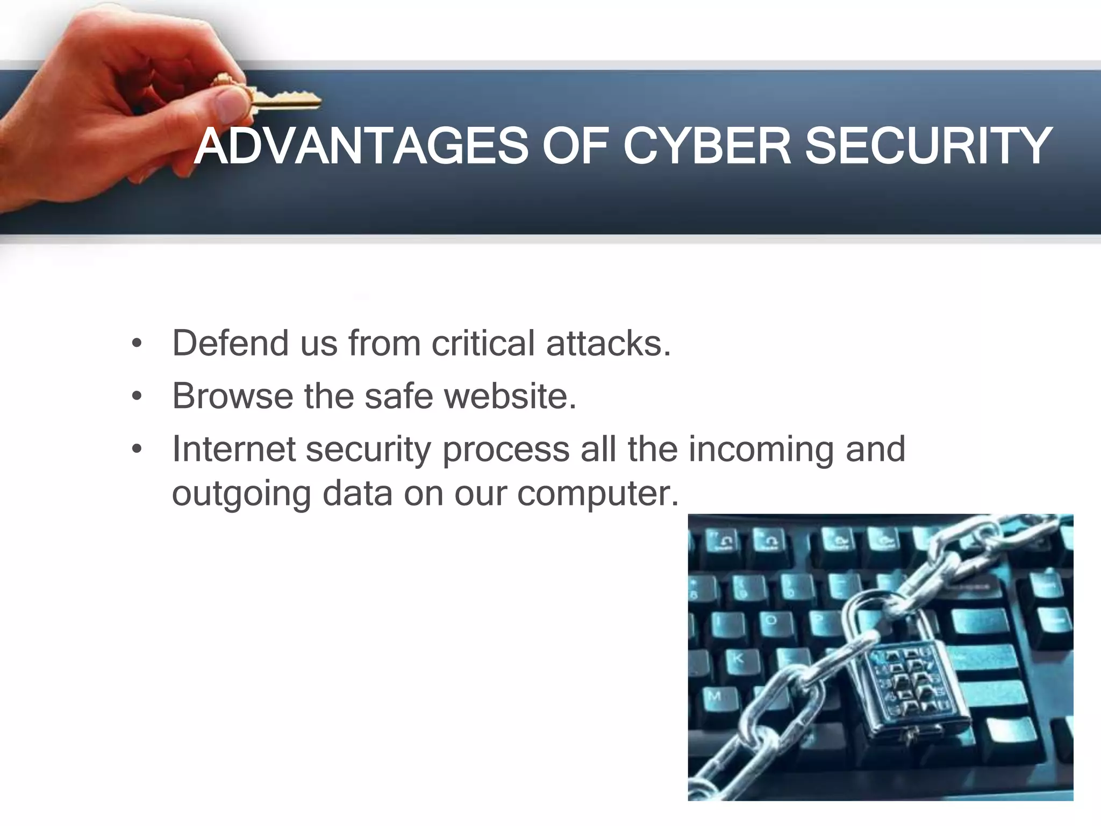
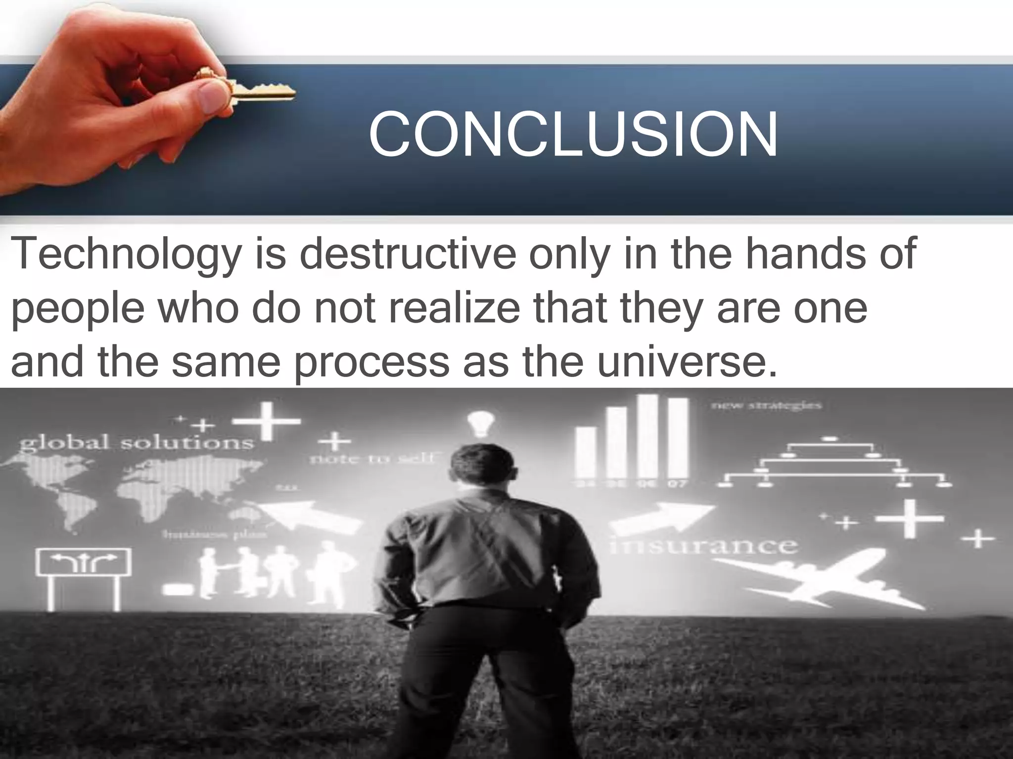
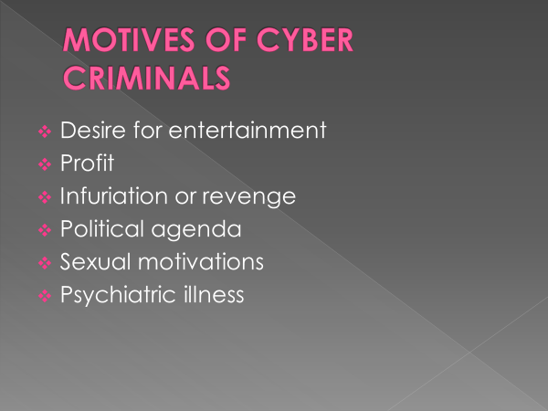

Slide 12
Type of Cybercrime
The following list presents the common types of cybercrimes:
Computer Fraud: Intentional deception for personal gain via the use of computer systems.
Privacy violation: Exposing personal information such as email addresses, phone numbers, and account details, etc. on social media, hacking websites, etc.
Identity Theft: Stealing personal information from somebody and impersonating that person.
Sharing copyrighted files/information: This involves distributing copyright-protected files such as eBooks and computer programs etc.
Electronic funds transfer: This involves gaining un-authorized access to bank computer networks and making illegal fund transfers.
Electronic money laundering: This involves the use of a computer to launder money.
ATM Fraud: This involves intercepting ATM card details such as account numbers and PINs. These details are then used to withdraw funds from the intercepted accounts.
Denial of Service Attacks: This involves the use of computers in multiple locations to attack servers with a view of shutting them down.
Spam: Sending unauthorized emails. These emails usually contain advertisements.
unauthorized

Slide 13
What is Legal Framework ?
The rules, rights, and obligations (দায়িত্ব) of companies, governments, and citizens are outlined in a system of legal documents called a legal framework.
• Documents in the legal framework include a country's constitution, legislation, policy, regulations, and contracts.
Legal frameworks comprise a set of documents that include the constitution (সংবিধান), legislation (প্রণীত আইনসমূহ), regulations (লিখিত আইন), and contracts.

Slide 14
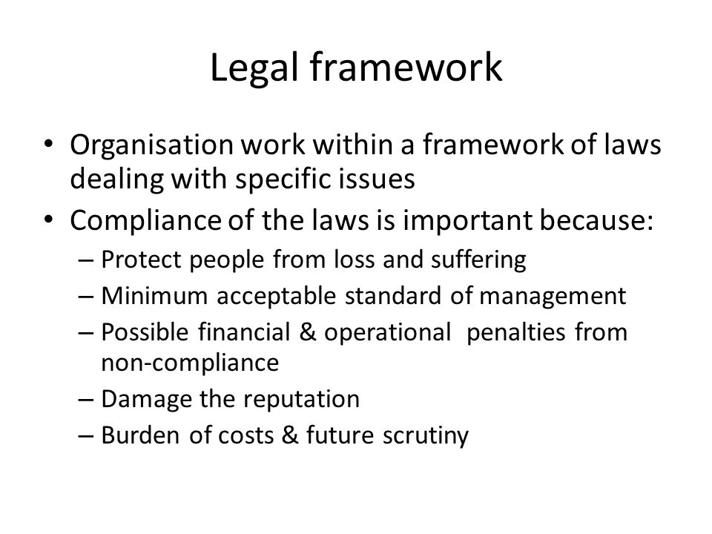
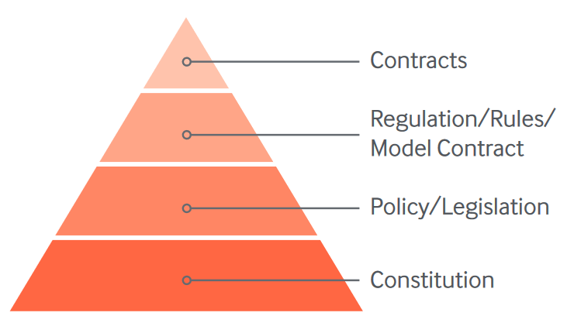
Figure. The Legal
Hierarchy

Slide 15
Cyber Crimes & Legal Framework
There are adequate laws concerning cybercrime in Bangladesh but there is no efficient enforcement (প্রয়োগ). Laws relating to cybercrime are Information and Communication Technology Act, 2006, Bangladesh the Penal Code, 1860, The Pornography Control Act, 2012 pg. 16), and the Bangladesh Telecommunication Act, 2001.
Cybercrime policies/strategies
Bangladesh does not have any officially recognized national cybercrime policies/strategies.
However, the Government of Bangladesh framed the National Cybersecurity Strategy of Bangladesh (Gazette-2014) for protecting cyber world against security threats, risks and challenges to national security. The Strategy addresses the country’s national security strategy. The purpose of this document is to create a coherent vision for 2021 keeping Bangladesh secure and prosperous by coordinating government, private sector, citizens and international cyberspace defense efforts.
The Government of Bangladesh also framed National ICT Policy 2009.

Slide 16
Cybercrime legislation
Cybercrime legislation
State of cybercrime legislation
Substantive law
Procedural law
The main general framework available to all cybercrime investigations is embodied in the Bangladesh Information and Communication Technology (ICT) Act as also Bangladesh Code of Criminal Procedure, 1898, and Bangladesh Evidence Act, 1872. Some procedures are included in the Digital Security Act 2018 – search and seizure with and without warrant.
Safeguards
Specialised institutions
Chapter Eight of the ICT Act creates a Cyber Tribunal and Cyber Appellate Tribunal to adjudicate of cybercrimes.
There are some Cybercrime prevention agencies like The Bangladesh Telecommunication Regulatory Commission (BTRC), Bangladesh Computer Security Incident Response Team (bdCERT) have been set up for the purpose of curbing cybercrimes.
Bangladesh has also set up various specialized cybercrime police stations. Cyber incident response unit and ‘a cybercrime investigation cell’ and ‘IT Crime Forensic Lab’ are set up by the Bangladesh police to fight against cybercrime or crime related with computer and other IT technology.
In the Digital Security Act 2018, a Digital Security Agency is established, in order to ensure the fulfilling of the Act.

Slide 17
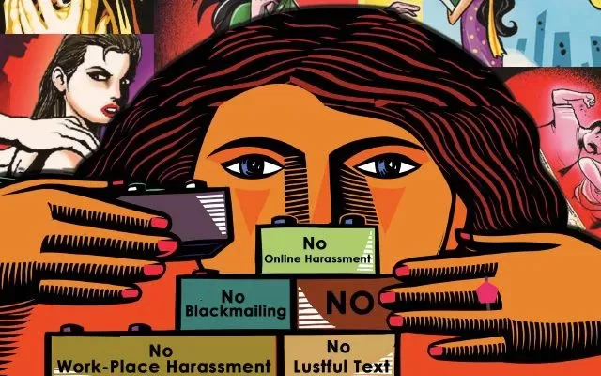
Cyber Crimes and Women
https://www.rksassociate.com/cyber-crimes-and-women/

Slide 18
Cyber crime may be defined as “Any unlawful act where computer or communication device or computer network is used to commit or facilitate the commission of a crime”.
Various cyber crimes against women
Harassment through e-mails
Cyber stalking
Cyber defamation
Cyber sexual defamation
Morphing (রূপান্তর) changes smoothly from one image to another in small gradual steps using computer animation techniques.
Email Spoofing (ঠকান, প্রতারণা করা)
Hacking
Cyber Pornography
Cyber bullying

Slide 19
Spoofing (প্রতারণা করা) is a type of scam(কেলেঙ্কারি) in which a criminal disguises (ছদ্মবেশ) an email address, display name, phone number, text message, or website URL to convince a target that they are interacting with a known, trusted source.

Slide 20
Hacking
Hacking is identifying and exploiting weaknesses in computer systems and/or computer networks. Cybercrime is committing a crime with the aid of computers and information technology infrastructure. Ethical Hacking is about improving the security of computer systems and/or computer networks.
https://www.simplilearn.com/tutorials/cyber-security-tutorial/types-of-cyber-attacks

Slide 21
What is the difference between hacking and cybercrime?
Hacking is the process of locating and taking advantage of holes in computer networks and/or systems. Cybercrime is the term for committing a crime while using computers and other information technologies.
What is cyber-attacks or hacking?
When there is an unauthorized system/network access by a third party, we term it a cyber attack. The person who carries out a cyberattack is termed a hacker/attacker. Cyber-attacks have several negative effects.
Why is hacking a cybercrime?
A commonly used hacking definition is the act of compromising digital devices and networks through unauthorized access to an account or computer system. Hacking is not always a malicious act, but it is most commonly associated with illegal activity and data theft by cybercriminals.

Slide 22


Hacker
A Hacker is a person who finds and exploits the weaknesses in computer systems and/or networks to gain access. Hackers are usually skilled computer programmers with knowledge of computer security.
Types of Hackers
Hackers are classified according to the intent of their actions. The following list classifies types of hackers according to their intent:
Symbol | Description
 | Ethical Hacker (White hat): A security hacker who gains access to systems with a view to fix the identified weaknesses. They may also perform penetration Testing and vulnerability assessments.
 | Cracker (Black hat): A hacker who gains unauthorized access to computer systems for personal gain. The intent is usually to steal corporate data, violate privacy rights, transfer funds from bank accounts etc.

Slide 23


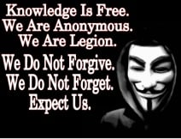

Symbol | Description
 | Grey hat: A hacker who is in between ethical and black hat hackers. He/she breaks into computer systems without authority with a view to identify weaknesses and reveal them to the system owner.
 | Script kiddies: A non-skilled person who gains access to computer systems using already made tools.
 | Hacktivist: A hacker who use hacking to send social, religious, and political, etc. messages. This is usually done by hijacking websites and leaving the message on the hijacked website.
 | Phreaker: A hacker who identifies and exploits weaknesses in telephones instead of computers.

Slide 24
Ethical hacking involves an authorized attempt to gain unauthorized access to a computer system, application, or data. Carrying out an ethical hack involves duplicating strategies and actions of malicious attackers.
What does an ethical hacker do?
An ethical hacker, also known as a 'white hat hacker', is employed to legally break into computers and networks to test an organization's overall security. Ethical hackers possess all the skills of a cyber criminal but use their knowledge to improve organizations rather than exploit and damage them.
https://www.guru99.com/what-is-hacking-an-introduction.html

Slide 25
What are the key concepts of ethical hacking?
Hacking experts follow four key protocol concepts:
Stay legal. Obtain proper approval before accessing and performing a security assessment.
Define the scope. Determine the scope of the assessment so that the ethical hacker’s work remains legal and within the organization’s approved boundaries.
Report vulnerabilities. Notify the organization of all vulnerabilities discovered during the assessment. Provide remediation advice for resolving these vulnerabilities.
Respect data sensitivity. Depending on the data sensitivity, ethical hackers may have to agree to a non-disclosure agreement, in addition to other terms and conditions required by the assessed organization.

Slide 26
Forgery (জালিয়াতি)
What is the meaning of forgery in a sentence?
an illegal copy of a document, painting, etc., or the crime of making such illegal copies: These banknotes are forgeries. He increased his income by forgery.
What are the 3 types of forgery?
What are the three types of forgery? Three common types of forgery are signature forgery, art forgery, and document forgery. Each of these types of forgery involves different methods of creating or altering documents, signifiers, and objects with the intent to deceive.
What are the 4 types of forgery?
There are four basic types of forgery: traced, simulation, freehand, and lifted.
Does forgery mean fake?
Forgery is a white-collar crime that generally refers to the false making or material alteration of a legal instrument with the specific intent to defraud.

Slide 27
Digital forgery
Digital forgery refers to the act of manipulating or altering digital content, such as images, videos, or documents, with the intention to deceive or mislead viewers.
What is the real example of digital forgery?
Just like forgery, it occurs when someone creates a fake object, a fake copy of a document or a fake limitation of a document. Great examples of digital forgery include: Forging a signature. Creating a replica of an expensive device.
What is a cyber forgery?
When a perpetrator alters documents stored in computerized form, the crime committed may be forgery. In this instance, computer systems are the target of criminal activity. Computers, however, can also be used as instruments with which to commit forgery.
,

Slide 28
Cyberstalking/ Harassment
Stalking - the crime of illegally following and watching someone over a period of time.
Stalking is unwanted and/or repeated surveillance by an individual or group toward another person. Stalking behaviors are interrelated to harassment and intimidation and may include following the victim in person or monitoring them. The term stalking is used with some differing definitions in psychiatry and psychology, as well as in some legal jurisdictions as a term for a criminal offense.
Stalk-harass or persecute (নির্যাতন করা) (someone) with unwanted and obsessive (খুব বেশী)attention.
Doxxing (also spelled “doxing”) is the act of revealing someone's personal information online. Doxxing is a form of online harassment that means publicly exposing someone's real name, address, job, or other identifying info without a victim's consent.

Slide 29
Cyberstalking is the use of the Internet or other electronic means to stalk or harass an individual, group, or organization. It may include false accusations, defamation, slander, and libel (পরনিন্দা). It may also include monitoring, identity theft, threats, vandalism, solicitation for sex, doxing, or blackmail.
Cyberstalking is often accompanied by real-time or offline stalking. In many jurisdictions, such as California, both are criminal offenses. Both are motivated by a desire to control, intimidate, or influence a victim.
A stalker may be an online stranger or a person whom the target knows. They may be anonymous (বেনামী)and solicit (অনুরোধ, অনুনয় করা)the involvement of other people online who do not even know the target.
Cyberstalking is a criminal offense under various state anti-stalking, slander(অপবাদ), and harassment laws. A conviction(দণ্ডাজ্ঞা) can result in a restraining(নিরোধক) order, probation (পরীক্ষাকাল), or criminal penalties against the assailant (আততীয়), including jail.

Slide 30
Cyber Pornography (অশ্লীল রচনা)
printed or visual material containing the explicit description or display of sexual organs or activity, intended to stimulate sexual excitement.
What is the definition of Pronography?
"Pornography" (or "porn") usually refers to representations designed to arouse and give sexual pleasure to those who read, see, hear, or handle them.
Cyber pornography can be defined as pornographic material designed, published or distributed using cyber space as a medium.
child pornography is illegal in all forms and has been banned universally.
The Pornography Control act of 2012 criminalizes pornography and possession, distribution and production of pornographic material is illegal in Bangladesh. Maximum punishment for producing pornography is up to 7 years of imprisonment with hard labour with fines up to 200,000 BDT.

Slide 31
Identity Theft & Fraud;
What are identity theft and identity fraud?
Identity theft and identity fraud are terms used to refer to all types of crime in which someone wrongfully obtains and uses another person's data in some way that involves fraud or deception (প্রতারণা), typically for economic gain.
What are the 4 types of identity theft?
The four types of identity theft include medical, criminal, financial, and child identity theft. Medical identity theft occurs when individuals identify themselves as another to procure(রাজী করান) free medical care.
Criminal identity theft occurs when someone cited or arrested for a crime uses another person's name and identifying information, resulting in a criminal record being created in that person's name.
Financial identity theft is when thieves use stolen credit to make fraudulent purchases. Thieves also use stolen bank account numbers, debit card numbers, or other personal and financial information to wipe out accounts, take out loans and/or get credit cards.
Child identity theft occurs when someone uses a minor's personal information, such as name, date of birth or Social Security number to fraudulently gain credit or other benefits. Creditors do not verify age of applicants.

Slide 32
What are the techniques of identity theft and fraud?
The identified categories are:
Physical Theft: examples of this would be dumpster diving, mail theft, skimming, change of address, reshipping, government records, and identity consolidation(একীকরণ).
Technology-Based: examples of this are phishing, pharming, DNS Cache Poisoning, wardriving, spyware, malware, and viruses.
# Dumpster - a brand name for a large container for waste, with a lid that is fixed along one edge, used outside restaurants and shops, in apartment buildings, etc.
# Skimming-the practice of stealing someone's credit card details using electronic equipment, in order to use their account illegally.
The practice of stealing money from an account, budget, etc. over a period of time in amounts that cannot be easily noticed.
The practice of charging a high price for a new product in order to make as much profit as possible before other similar products become available and prices fall:

Slide 33
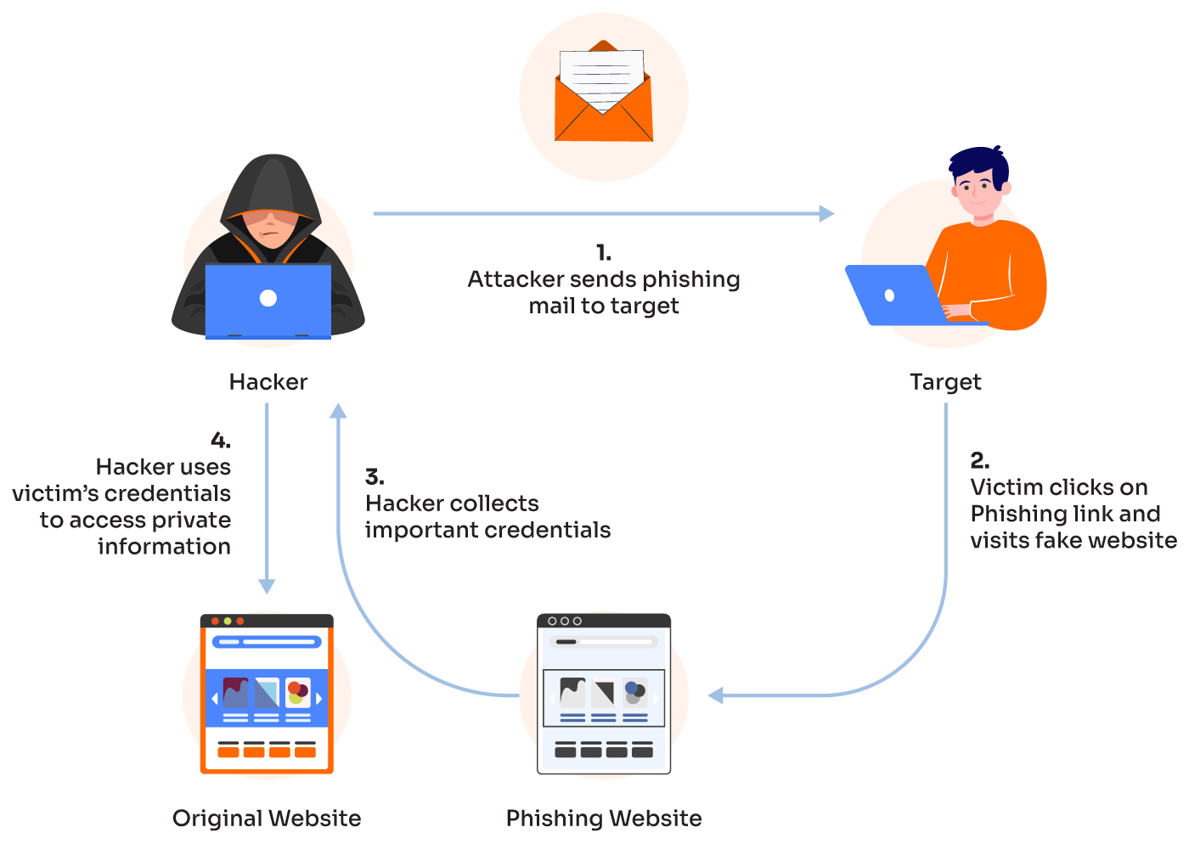
#Phishing -an attempt to trick someone into giving information over the internet or by email that would allow someone else to take money from them, for example by taking money out of their bank account

Slide 34
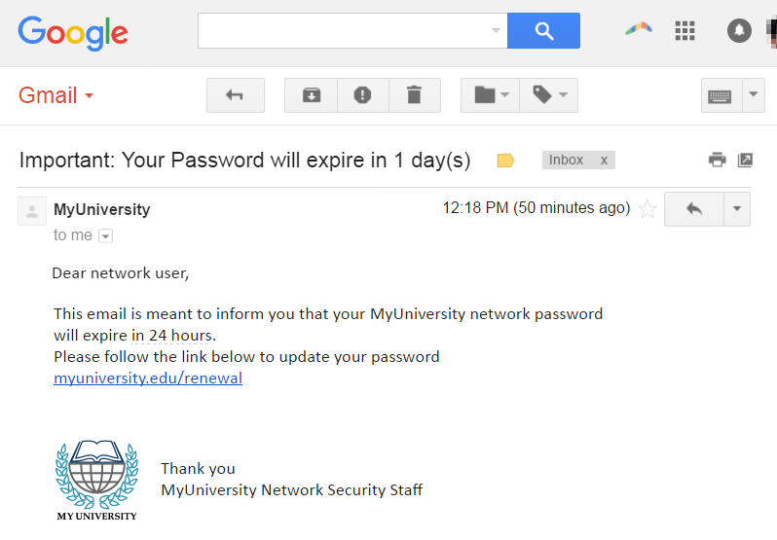
Phishing
The fraudulent practice of sending emails or other messages purporting to be from reputable companies to induce individuals to reveal personal information, such as passwords and credit card numbers.

Slide 35
Why is it called phishing?
The Story Behind The Name “Phishing” Analogous to fishing, phishing is also a technique for " fishing” for usernames, passwords, and other sensitive information from a “sea” of users. Hackers generally use the letter “ph” instead of “f”; therefore, they were initially known as phreaks.
Phreaks: Hack into telecommunications systems, especially to obtain free calls.

Slide 36
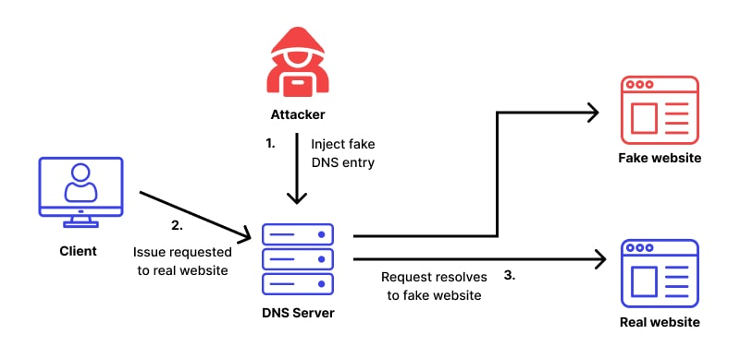
Pharming is online fraud that involves the use of malicious code to direct victims to spoofed websites in an attempt to steal their credentials and data. Pharming is a two-step process that begins with an attacker installing malicious code on a victim's computer or server.
How pharming works?

Slide 37
Top 10 Tips for Identity Theft Protection
Protect your Social Security number.
Fight "phishing" - don't take the bait.
Polish your password practices.
Be mysterious on social networks.
Shield your computer and smartphone.
Click with caution.
Check your statements.
Stop pre-approved credit offers.
Check your credit reports – for free.
Ask questions.
https://oag.ca.gov/idtheft/facts/top-ten

Slide 38
There are lots of ways that identity theft can happen—and the results can be devastating (causing a lot of damage or destruction) .
Account Takeover Fraud Debit Card Fraud or Credit Card Fraud Driver's License Identity Theft Mail Identity Theft Online Shopping Fraud Social Security Number Identity Theft Senior Identity Theft and Scams Child Identity Theft Tax Identity Theft Biometric ID Theft Synthetic Identity Theft Medical Identity Theft Mortgage (বন্ধক) Fraud Home Title Fraud Lost or Stolen Passport | Internet of Things Identity Fraud Friendly Identity Theft Employment Fraud Unemployment Fraud Crypto (গুপ্ত)Fraud https://www.experian.com/blogs/ask-experian/20-types-of-identity-theft-and-fraud/ A mortgage is an agreement between you and a lender that gives the lender the right to take your property if you fail to repay the money you've borrowed plus interest.

Slide 39
Cyber Terrorism;
Cyberterrorism : the politically motivated use of computers and information technology to cause severe disruption or widespread fear in society.
What is cyberterrorism? Cyber terrorism (also known as digital terrorism) is defined as disruptive attacks by recognized terrorist organisations against computer systems with the intent of generating alarm, panic, or the physical disruption of the information system

Slide 40
Examples of cyberterrorism
Introduction of viruses to vulnerable data networks.
Hacking of servers to disrupt communication and steal sensitive information.
Defacing websites and making them inaccessible to the public thereby causing inconvenience and financial losses.
Hacking communication platforms to intercept or stop communications and make terror threats using the internet.
Attacks on financial institutions to transfer money and cause terror.

Slide 41
How businesses can defend against cyberterrorism
Use strong passwords – there is software capable of guessing thousands of passwords in seconds, so a complicated password is a strong password. Follow password best practices, change them regularly, and avoid using the same password for multiple logins
Follow cyber security news – Keep up to date with cyber news and government warnings. Knowing the latest threats helps you prepare for potential acts of terrorism
Create a culture of cyber awareness – all employees should be actively engaged in cyber security education and attend regular training. Stress the importance of staying vigilant and being on the lookout for anything suspicious
Vet all third-party vendors – a business’s cyber security posture is only as strong as its third-party vendors. Businesses should demand transparency from vendors regarding cyber security practices before signing contracts or conducting any business.
What to do if a cyber threat is received via telephone
Record as many details as possible
If it’s an imminent threat call 999 or the anti-terrorist hotline at 0800 789 321
Cybersecurity
https://www.wigan.gov.uk/Resident/Crime-Emergencies/Counter-terrorism/Cyber-terrorism.aspx

Slide 42
Cyber Defamation (মানহানি);
Cyber Defamation is the act of publishing false or defamatory statements about an individual or organization on the internet. It can include statements made on social media, forums, blogs, or any other online platform.
What Is Online Defamation?
Defamation law has evolved over hundreds of years, with courts trying to balance one person's freedom of expression against another person's right to defend their reputation. The internet has allowed more free speech than ever before and more opportunities to trash someone's character with a post or a comment.
Traditional defamation cases involve newspaper articles, magazines, letters to the editor, and television and radio broadcasts. Online defamation happens on various platforms, including:
Facebook, Twitter, Instagram, TikTok NextDoor, LinkedIn, Reddit
Yelp and other review sites, and
blogs.
Defamation is a civil wrong (called a "tort") in most states—you can sue someone for money over it. But harassment and cyberbullying are crimes that can lead to a jail or prison sentence.
https://www.nolo.com/legal-encyclopedia/social-media-online-defamation.html
https://blog.ccasociety.com/cyber-defamation/

Slide 43
Few Measures for Online Safety:
Choose a safe online name. Pick a name that doesn’t reflect your complete identity or location.
Have a strong password with the alpha-numeric symbol and special characters for your online account.
Secure your computers with anti-virus, anti-spyware, and other cyber security tools.
Be selective about what information you make public. Be cautious while posting online any information that can personally identify you, a family member, or friend on a public site.
Never, try to meet a person with whom you’ve interacted only online without taking somebody else along and such a meeting must always be in a public place.
Pay attention to privacy policies on Websites and in software.
Guard your email address.
Last, but not least, trust your instinct. If you are being subjected to any form of cyber bullying or harassment, report it at once

Slide 44
Types of Cybercrime
Cybercrime distinguishes between four different types of offenses:
1. Cybercrime against Individuals.
2. Cybercrime against Property.
3. Cybercrime against Organizations/ institutions/ companies.
4. Cybercrime against Society/ government/ state.

Slide 45
Problem Areas:
1. Telecommunications
2. Electronic vandalism, terrorism, and extortion
3. Stealing telecommunications services
4. Telecommunications piracy
5. Pornography and other offensive material
6. Telemarketing fraud
7. Electronic fund transfer crime

Slide 46
Classifications of Cybercrimes
Cybercrimes in general can be classified into four categories:
1. Individual Cyber Crimes:
This type is targeting individuals. It includes phishing, spoofing, spam, cyberstalking, and more.
2. Organization Cyber Crimes:
The main target here is organizations. Usually, this type of crime is done by teams of criminals including malware attacks and denial(অস্বীকার) of service attacks.
3. Property Cybercrimes:
This type targets property like credit cards or even intellectual property rights.
4. Society Cybercrimes:
This is the most dangerous form of cybercrime as it includes cyber-terrorism.

Slide 47
Categories of Cyber Crime
Generally, there are three major categories of cybercrimes that you need to know about. These categories include:
Crimes Against People. While these crimes occur online, they affect the lives of actual people. Some of these crimes include cyber harassment and stalking, distribution of child pornography, various types of spoofing, credit card fraud, human trafficking, identity theft, and online-related libel or slander.
Crimes Against Property. Some online crimes happen against property, such as a computer or server. These crimes include DDOS attacks, hacking, virus transmission, cyber and typosquatting, computer vandalism, copyright infringement, and IPR violations.
Crimes Against Government. When a cybercrime is committed against the government, it is considered an attack on that nation's sovereignty and an act of war. Cybercrimes against the government include hacking, accessing confidential information, cyber warfare, cyber terrorism, and pirated software.

Slide 48
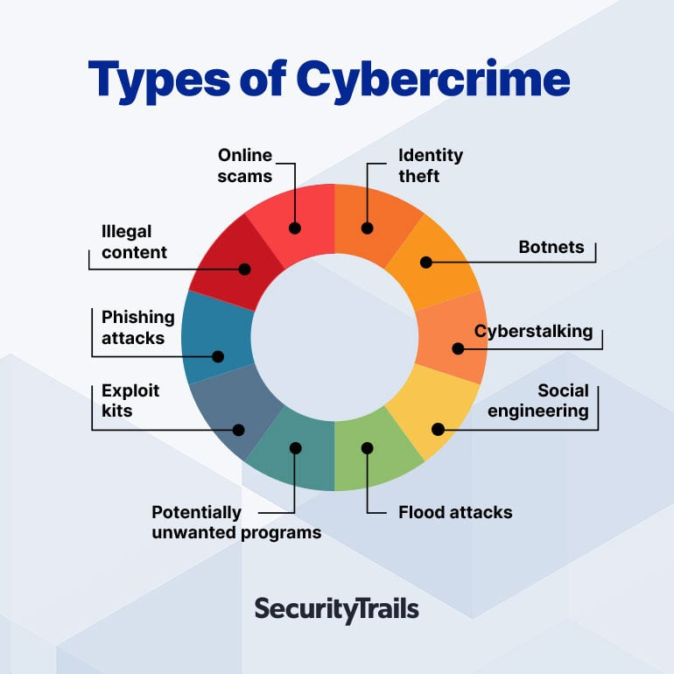
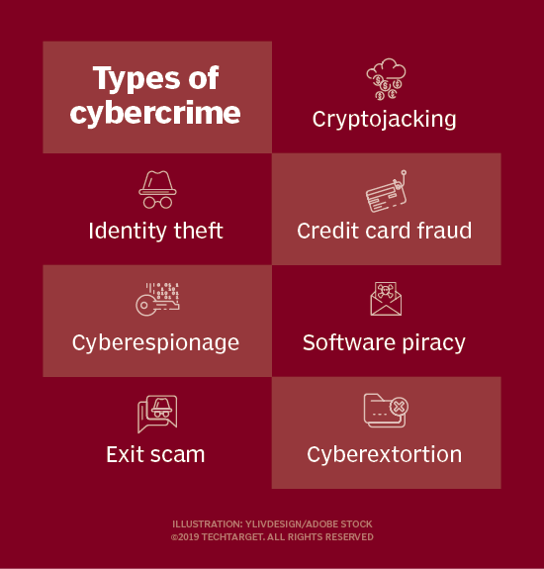

Slide 49
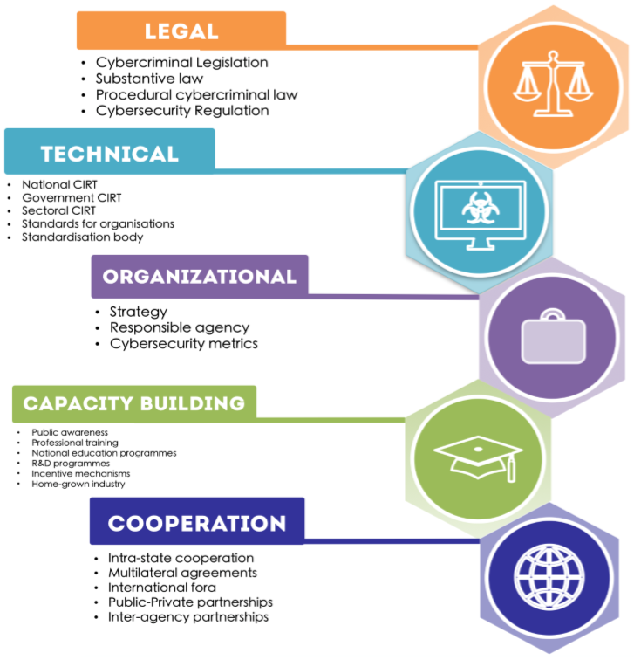
Pillars of the Global Cybersecurity Index
Computer Incident Response Team (CIRT)

Slide 50
What is the Cybercrime Act in Bangladesh?
Cybercrime legislation Bangladesh Information and Communication Technology (ICT) Act, 2006 amended in the year of 2009 & 2013 defines and amends certain parts of law relating to legal recognition and security of information and communication technology and related matters.

Slide 51
What is an example of an individual cybercrime?
Types of Cybercrime - Panda Security Mediacenter
Individual: This category of cybercrime involves one individual distributing malicious or illegal information online. This can include cyberstalking, distributing pornography and trafficking.

Slide 52
Definition of Cybercrime Against Individual https://www.ezylegal.in/blogs/cybercrime-against-individuals-in-india
Cybercrime against individuals primarily involves activities that involve the use of the internet and computers as a tool to extract private information from an individual, either directly or indirectly, and disclose it on online platforms without the person’s consent or illegally to degrade the person’s reputation or cause mental or physical harm.
Types of Cybercrime against Individuals
Cybercrime may be broadly classified into three types:
1. Cybercrime against an individual is a type of cybercrime that occurs in or through the internet. Sexual, ethnic, religious, or other forms of harassment exist.
2. Cybercrime against an individual’s property includes computer wreckage, the destruction of other people’s property, the delivery of destructive programs, trespassing, and unlawful possession of computer information.
3. Cybercrime against the government, such as cyberterrorism or plotting against the governmental activities

Slide 53
Examples of Cybercrime against Individual
1. Phishing and Scam:
Phishing is a sort of social engineering attack and cybercrime against an individual where the attacker deceives them by sending phony messages and emails in order to get sensitive information about the user or to attempt to download malicious software and exploit it on the target machine.
2. Theft of Identity:
Identity theft happens when a cybercriminal utilizes another person’s personal information, such as credit card details or personal photographs, to perpetrate fraud or a crime without their permission.
3. Ransomware Infection:
Ransomware attacks are a sort of cybercrime against individuals that is fairly widespread. It is a sort of virus that may restrict users from accessing all of their personal data on the device by encrypting it and then demanding a ransom to get access.
4. Malware Attacks:
These are cyber crimes against individuals who use cell phones with internet access and are sometimes tracked for their location, online searches, usernames, and passwords input on their devices, webcams, and so on.
5. Cyberstalking:
Cyberstalking is a type of cybercrime against an individual where someone follows somebody on social media, online websites, or search engines, exposing the user to a barrage of online messages or emails threatening his or her safety.
6. Social Media Hacking:
Hacking on social media is a cybercrime against an individual when someone creates a phoney account and gains the followers or friends of the general public. This then provides the false account the ability to send out mass emails to inboxes.
7. Web Jacking:
Digital marketing has become the new normal, enticing firms to create their own websites. More website traffic suggests that more people are aware of their products/services/brands.

Slide 54
Cybercrime Against Individuals
Email spoofing : A spoofed email is one in which the e-mail header is forged so that mail appears to originate from one source but has been sent from another source
Spamming : Spamming means sending multiple copies of unsolicited emails or mass e-mails such as chain letters.
Cyber Defamation : This occurs when defamation takes place with the help of computers and/or the Internet. E.g. someone publishes defamatory matter about someone on a website or sends e-mails containing defamatory information.
Harassment & Cyberstalking : Cyber Stalking Means following the moves of an individual’s activity over the internet. It can be done with the help of many protocols available such as e- mail, chat rooms, and user net groups.

Slide 55
Definition of Cybercrime Against Institution
Unauthorized Accessing of Computer: Accessing the computer/network without permission from the owner. it can be of 2 forms:
Changing/deleting data: Unauthorized changing of data.
Computer voyeur: The criminal reads or copies confidential or proprietary information, but the data is neither deleted nor changed.
Denial Of Service: When an Internet server is flooded with continuous bogus requests to denies legitimate users to use the server or to crash the server.
Computer contamination / Virus attack : A computer virus is a computer program that can infect other computer programs by modifying them in such a way as to include a (possibly evolved) copy of it. Viruses can be file infecting or affecting the boot sector of the computer. Worms, unlike viruses, do not need a host to attach themselves to.
Email Bombing : Sending large numbers of emails to the individual or company or mail servers thereby ultimately resulting in crashing.
Salami Attack : When negligible amounts are removed & accumulated into something larger. These attacks are used for the commission of financial crimes.
Logic Bomb : It’s an event-dependent program, as soon as the designated event occurs, it crashes the computer and releases a virus or any other harmful possibilities.
Trojan Horse : an unauthorized program that functions from inside what seems to be an authorized program, thereby concealing what it is doing.
Data diddling : This kind of attack involves altering raw data just before it is processed by a computer and then changing it back after the processing is completed.
The

Slide 56
Against Property:
Credit Card Fraud :
Intellectual Property crimes : These include Software piracy: illegal copying of programs, and distribution of copies of software.
Copyright infringement:
Trademarks violations: Theft of computer source code:
Internet time theft : the usage of the Internet hours by an unauthorized person which is paid by another person
Against Society
Forgery: currency notes, revenue stamps, mark sheets etc can be forged using computers and high-quality scanners and printers.
Cyber Terrorism: Use of computer resources to intimidate or coerce others.
Web Jacking: Hackers gain access and control over the website of another, even if they change the content of the website to fulfill political objective or for money.
,

Slide 57
Different offenses under ICT Act, 2006.
.

Slide 58
What is Intellectual Property?
Intellectual property (IP) refers to creations of the mind, such as inventions; literary and artistic works; designs; symbols, names, and images used in commerce.
IP is protected in law by, for example, patents, copyrights, and trademarks, which enable people to earn recognition or financial benefit from what they invent or create. By striking the right balance between the interests of innovators and the wider public interest, the IP system aims to foster an environment in which creativity and innovation can flourish.
https://www.wipo.int/about-ip/en/

Slide 59
What is intellectual property?
Intellectual property refers to any intellectual creation, such as literary works, artistic works, inventions, designs, symbols, names, images, computer code, etc.
Intellectual property law exists to protect the creators and covers areas of copyright, trademark law, and patents.
Thus, intellectual property is an umbrella term encompassing both copyright and industrial property, such as trademarks, patents, and inventions.

Slide 60
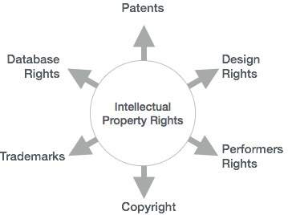
Industrial designs
Geographical indications
Trade secrets
Trade secrets are intellectual property (IP) rights on confidential information which may be sold or licensed.

Slide 61
.
Who releases the world intellectual property indicators?
World Intellectual Property Indicators (WIPI) is an annual statistical report published by the World Intellectual Property Organization (WIPO).

Slide 62
What is a patent?
A patent is an exclusive right granted for an invention, which is a product or a process that provides, in general, a new way of doing something, or offers a new technical solution to a problem. To get a patent, technical information about the invention must be disclosed to the public in a patent application.
World Intellectual Property Indicators – 2023
Nov 6, 2023
IP Right applications | 2021 | 2022
Patents | 3,400,500 | 3,457,400
Trademarks * | 18,182,300 | 15,543,300
Industrial designs * | 1,513,800 | 1,482,600
Plant variety | 25,200 | 27,260

Slide 63
Is it patent or patented?
Noun The product is protected by patent. Verb The product was patented by its inventor.
What Is a Patent in Simple Terms? With Examples
A patent is the granting of a property right by a sovereign authority to an inventor. A patent provides the inventor exclusive rights to the patented process, design, or invention for a certain period in exchange for a complete disclosure of the invention.
What is patent and patentable?
A patentable invention must be novel, inventive and capable of industrial application, i.e. being made or used in any kind of industry. Products, processes and methods can all be patented.

Slide 64
Why are things patented?
A patent gives you the right to stop others from copying, manufacturing, selling or importing your invention without your permission. See protecting intellectual property. You get protection for a pre-determined period, allowing you to keep competitors at bay. You can then use your invention yourself.
Is patent an asset?
A patent is considered an intangible asset. This is because a patent does not have physical substance and provides long-term value to the owning entity.
3 types of patents
Utility patent
Design patent
Plant patent

Slide 65
.
Can you patent an idea?
Ideas are not patentable. US patent law holds that patents may only be granted on the physical manifestations of ideas—machines and products, but not the underlying ideas themselves.

Slide 66
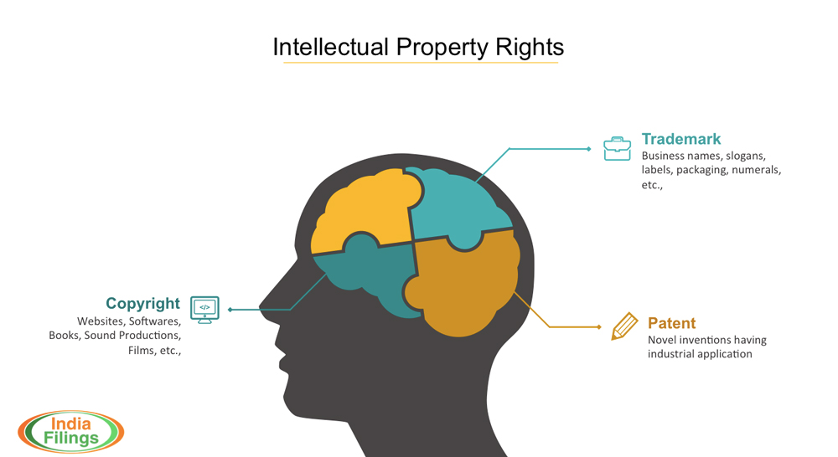
https://www.indiafilings.com/learn/intellectual-property-rights/

Slide 67
Who controls intellectual property rights?
Intellectual Property Rights and Registration
In India, the intellectual property rights of trademarks and patents are controlled by the Controller General of Patents Designs and Trademarks, Department of Industrial Policy and Promotion, Ministry of Commerce and Industry.
Who has the power to create intellectual property?
Article 1, Section 8, Clause 8 of the United States Constitution gives Congress the power to create a robust intellectual property (IP) system in order to promote the progress of science and useful arts.to

Slide 68

Who leads the world in patents?
In a ranking of patents by Country, China leads with a total of around 695,400 international (PCT) patent applications filed per year, followed by the United States and Japan, respectively.

Slide 69
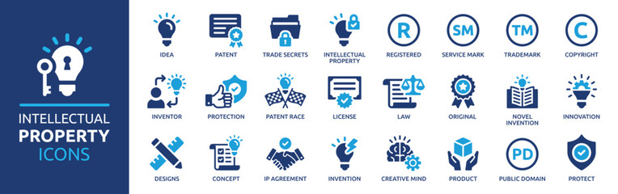
.

Slide 70
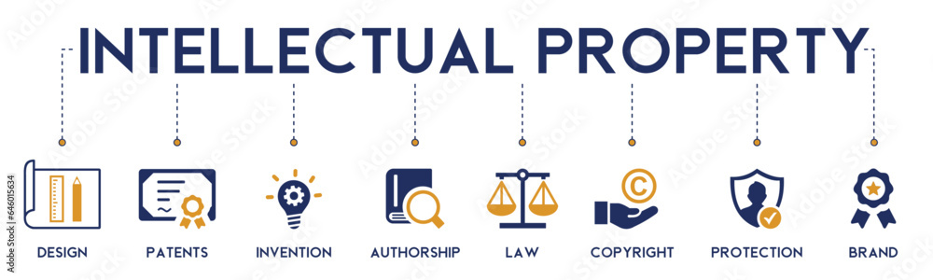
.

Slide 71
What is the meaning of patent pending?
What Is Patent Pending? The phrase patent pending is marked on a product as a notice that its inventor has begun the process of applying for exclusive rights to use, sell, or license the product.
https://www.investopedia.com/terms/p/patent-pending.asp
Can I sell a product that is patent pending?
Fortunately you do not have to wait until you have a full patent to sell your idea. You can sell a patent once you have received a “patent pending” status. Office (USPTO). With a patent pending status, the invention is protected against infringement.
Whose patent is pending?
The phrase “patent pending” (sometimes abbreviated “Pat. Pend.”) can be marked on a product or its packaging or marketing material (such as a website) to alert the public that the manufacturer has applied for a patent for the product (or some aspect of it). The phrase “patent applied for” can also be used.

Slide 72
What is copyright?
Copyright is a form of intellectual property. The U.S. Copyright Office defines copyright as. A set of exclusive rights awarded to a copyright holder or owner for an original and creative work of authorship fixed in a tangible medium of expression.
What is an example of intellectual copyright?
Intellectual property can take many forms and includes things like artwork, symbols, logos, brand names, and designs, among others. Companies are diligent when it comes to identifying and protecting intellectual property because it holds such high value in today's increasingly knowledge-based economy.
https://www.copyright.gov/what-is-copyright/

Slide 73
What are some examples of copyright works? The following are just a few examples of works in which copyright subsists:
Artistic works | Computing | Business
A Novel A poem A photograph A movie Lyrics to a song A musical composition in the form of sheet music A sound recording A painting A plan for a building | Computer software application Software code for a programming tool or software application Software code for a website Software code that manages a database | A database Text of a marketing plan or business plan Numbers and calculations in a financial forecast Architectural plans Annual reports A manual for the operation of equipment Technical specifications for a device Business proposals Letters and emails sent by a business

Slide 74
What is a Trademark?
https://tahmidurrahman.com/trademark-registration-in-bangladesh/

Slide 75
What is industrial property?
Industrial property is a form of intellectual property that includes inventions, patents, trademarks, industrial designs, and geographical indications of source (i.e., products that are closely identified with their geographical places of origin).
(Source and more information: WIPO: http://www.wipo.int/designs/en/​)

